Slide 1

5G Broadcast: Updates from standards, interoperability and implementations
IBC 2026
September 13, 2026
@qualcomm_tech
Dr. Thomas Stockhammer
Senior Director Technical Standards
Qualcomm Technologies

Slide 2
5G Broadcast for Qualcomm
Standards
Some global news
Technologies
Adoption Path

Slide 3
5G defines two modes of broadcast communication
Focus of this presentation
5G broadcast
Mixed-mode multicast
Broadcast spectrum (e.g. UHF)
No unicast. Downlink – only traffic.
Delivery of linear content (e.g. TV) or IP file delivery
Dedicated broadcast infrastructure (can be high power)
Operator spectrum (IMT)
Integration with unicast network
Efficient delivery of multicast/broadcast traffic (vs unicast)
Reuse of cellular infrastructure (low power).
Single Frequency Network (SFN) for downlink broadcast only
Dynamic switching between broadcast and unicast, e.g., SC-PTM¹
Addressing diverse ecosystem, deployment, and use case requirements

Slide 4
5G Broadcast – Core Features for multiple use cases
SIM-less reception, Receive-Only Mode (ROM) & Free-to-Air (FTA)
Different spectrum options (e.g. UHF, SDL), as well as SFN/MFN
Various deployment possibilities (e.g. MNOs, BNOs)
Using existing infrastructure (HPHT, MPMT and LPLT)
Highly flexible velocities (up to 250 KM/h Vs up to 300 µS)
Can be combined with existing 4G and 5G features (unicast, PWS)
Performance en par and Co-existence with legacy broadcast

Slide 5
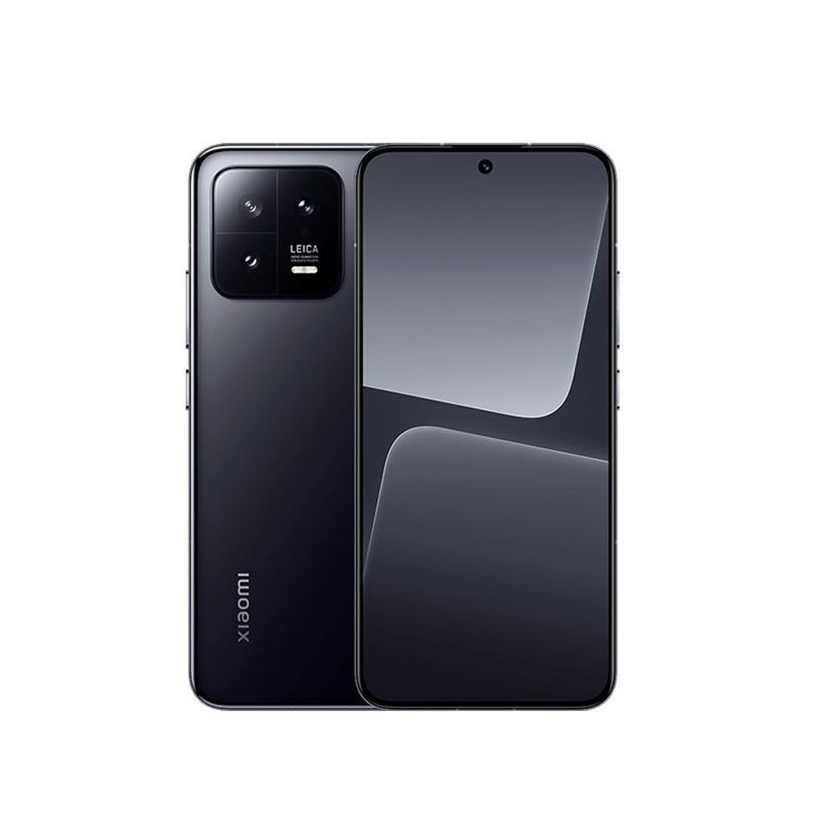



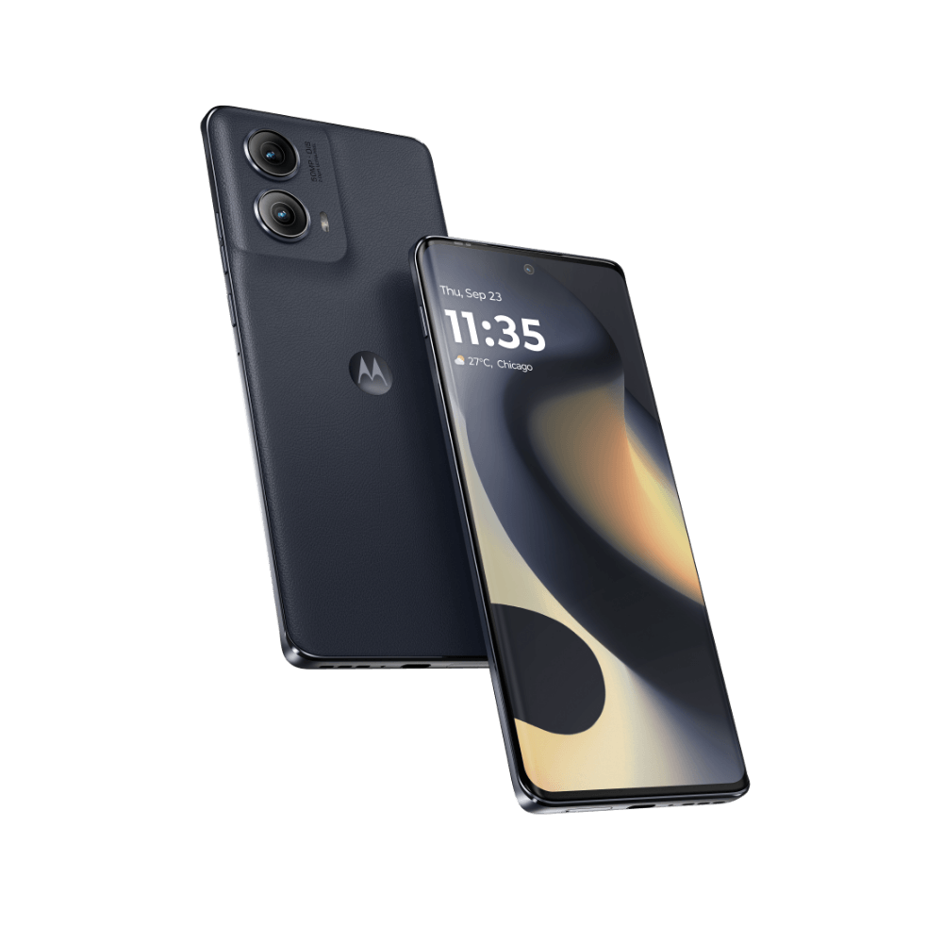
Why 5G Broadcast for mobile?
5G Broadcast reuses several building blocks of 4G/5G cellular modem ➔ it is a modem feature
5G Broadcast in a mobile device doesn’t require separate demodulator chip as is the case with other broadcast standards
Building block | Hardware (HW) / Software (SW) / Firmware (FW) | 5G Broadcast | Legacy Broadcast (DVB, ATSC, etc.)
RF | HW | Requires new components depending on supported band
OFDM IFFT | HW | Can reuse 4G/5G HW | May reuse 4G/5G HW
Searcher | HW / FW | Same as 4G/5G | Different
Tone/LLR mapping | HW | Same as 4G/5G | Different
Modulation de-mapper | HW | Same as 4G/5G | Different
Coding / packet segmentation | HW | Same as 4G/5G | Different
Scrambling | HW | Same as 4G/5G | Different
RAN protocol stack | SW | Same as 4G/5G | Different
A testament is the ability we can demonstrate 5G Broadcast in limited functionality with off the shelf phones
More available
OnePlus 10 Pro
OnePlus 10T
Xiaomi Mi 13
Motorola Razr
Motorola Edge

Slide 6
Standardization and Technology updates

Slide 7
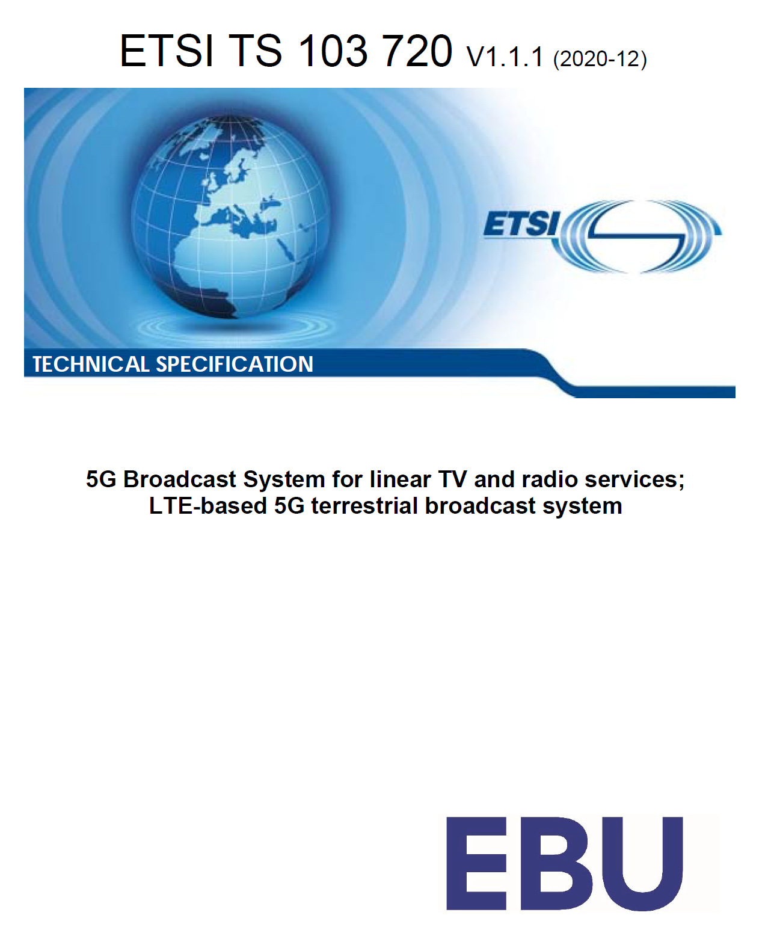
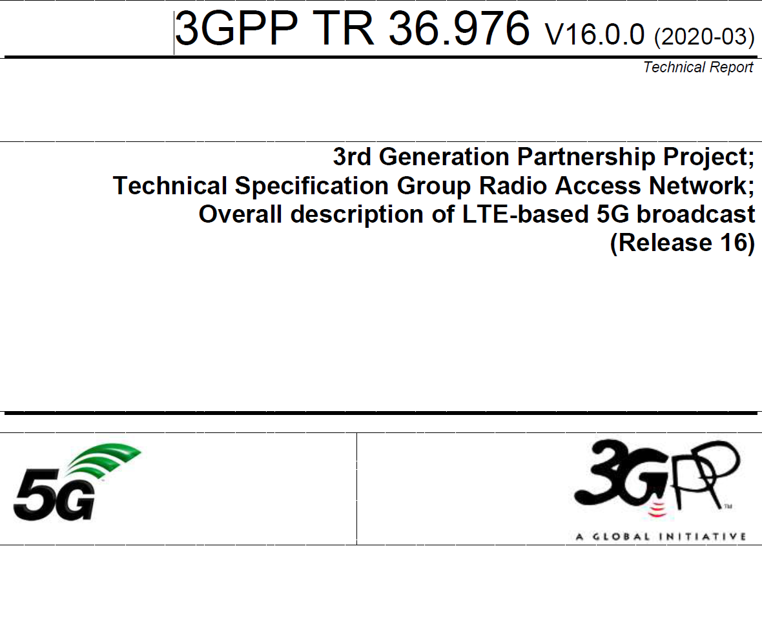
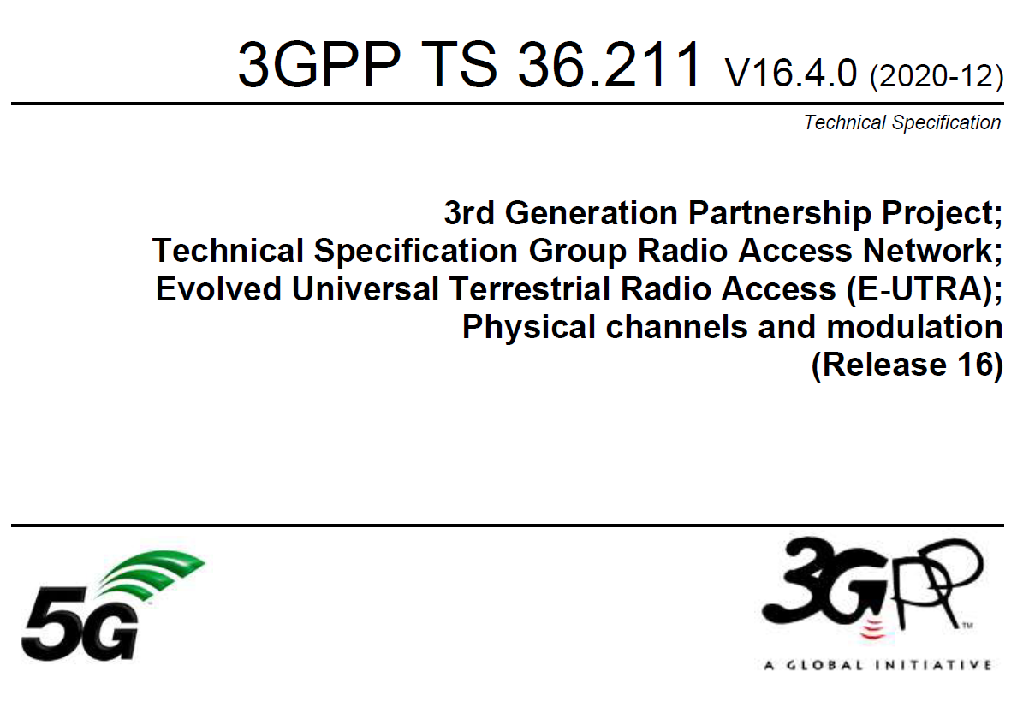
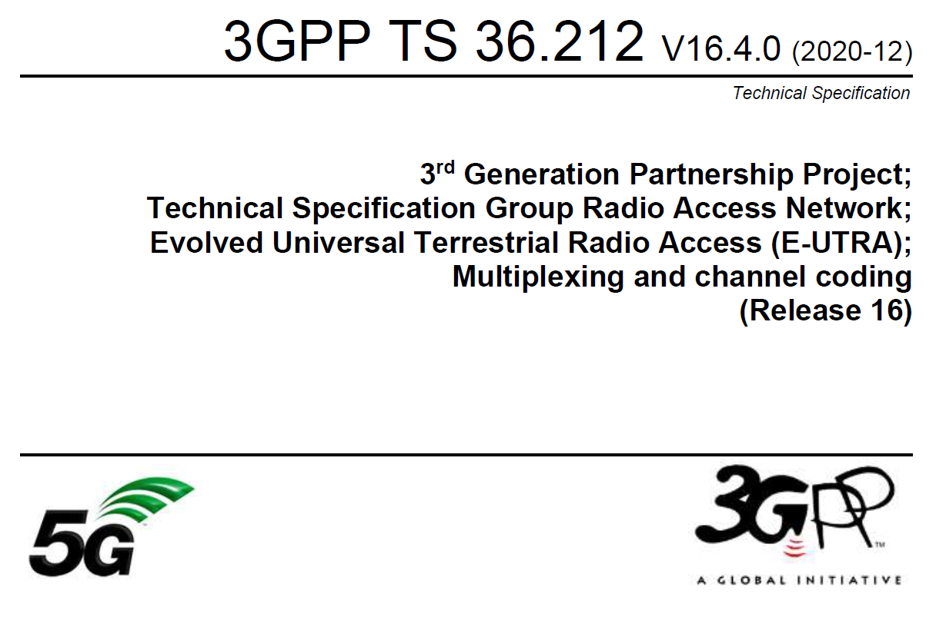
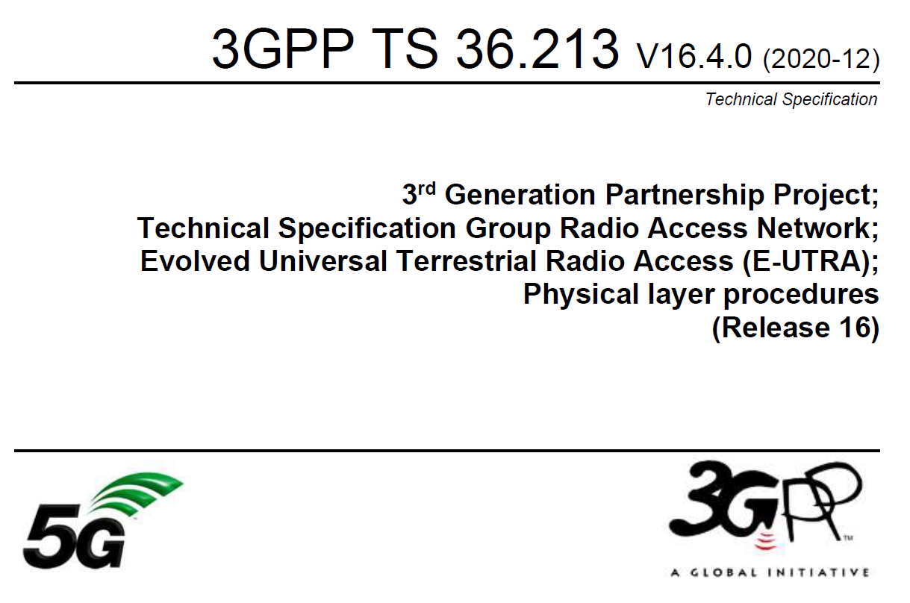
ETSI TS 103 720: Profile of 3GPP specification containing the necessary parts to deploy 5G broadcast
TR 36.976: Overall description
of enhanced TV (enTV) for
5G broadcast
For more information on 5G broadcast standards…
Various specifications
of 5G PHY supporting broadcast together
with unicast in TS 36.211, 36.212,
36.213

Slide 8
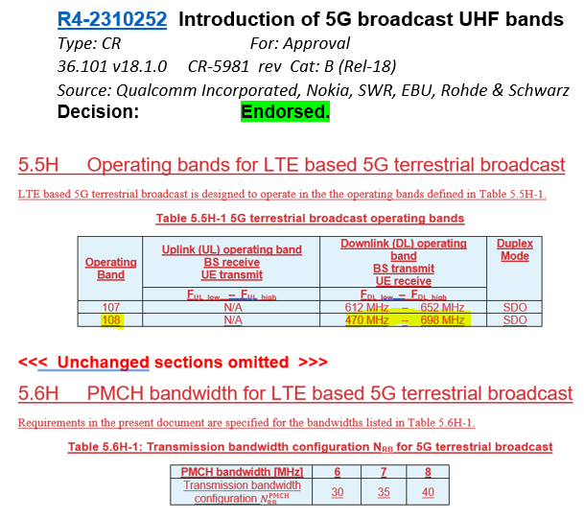
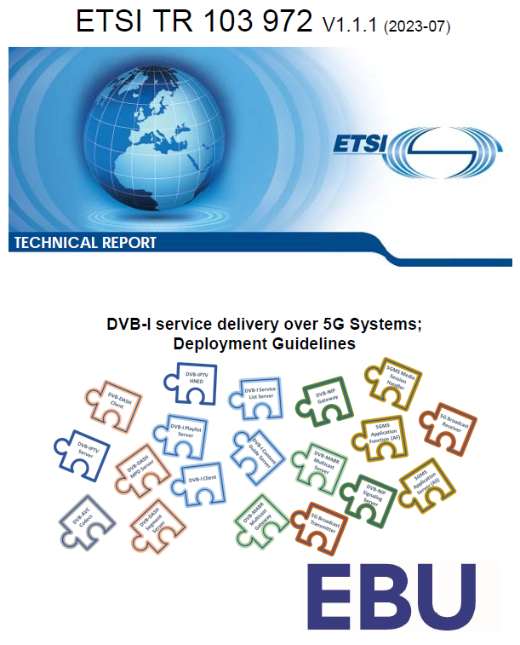
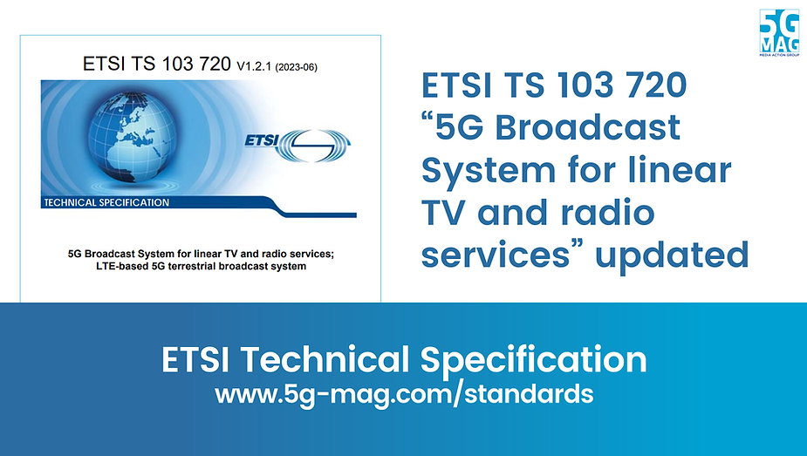
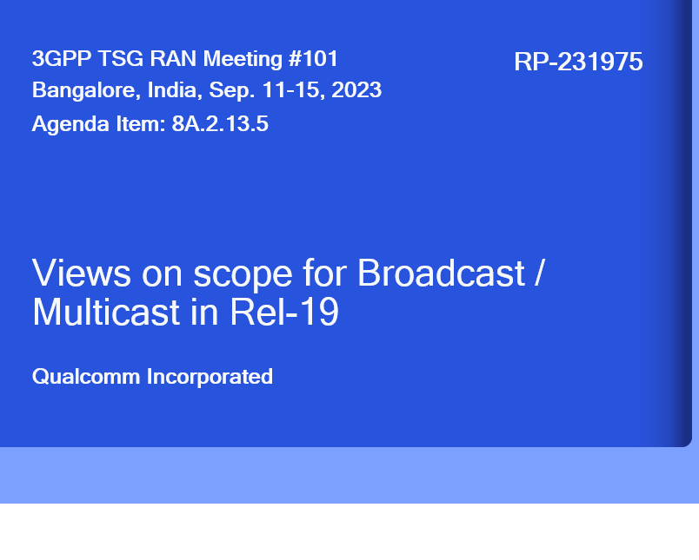
5G Broadcast Standards Evolution
Rel-14
SCS1.25KHz/ CP=200µs Mobility up to 120 km/h
5G BC worldwide standard
TG6/1 and WP6A
Rel-16
Rooftop Mobility up to 250 km/h
5G BC is an EU standard (ETSI TS 103 720)
Rel-17
Enhanced BW= 6/7/8 MHz for UHF
Enhanced Version of ETSI TS 103 720v.1.2.1
Enhanced Version of ETSI TS 103 720v.1.3.1
Rel-18
Requirements for UHF band, URL Handling
Rel-19 work (TFI, Co-existence, New bands)
Where do we stand?
ETSI
5G-MAG
ETSI
5G-MAG
3GPP
ITU
3GPP
ETSI
3GPP
3GPP
3GPP
2017
2019
2020
2020
06/22
06/23
12/23
06/25
12/26

Slide 9

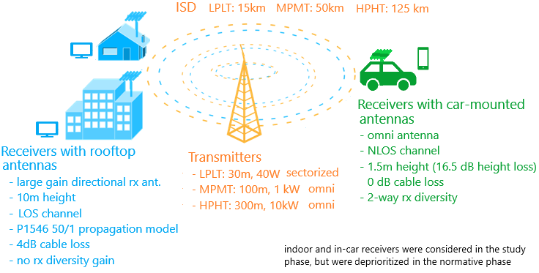
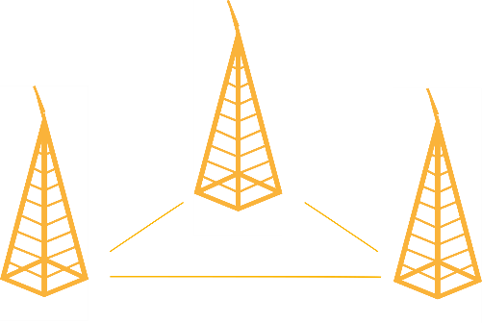

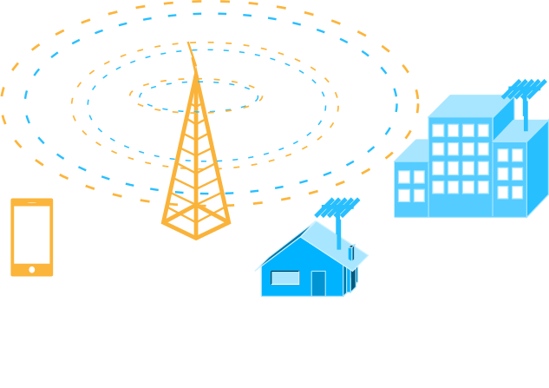
RAN: MBMS ➔ 5G Broadcast Evolution
Release 19
Release 18
CAS Muting for co-existence with legacy broadcast
Time-Frequency Interleaving coverage enhancements
Introduction of UHF Band 112 and 113 to support early deployments
Release 16
6/7/8 MHz channel bandwidth to support common global channel bandwidth for broadcast systems
Introduction of UHF Band 108 to address RF transmitter and receiver requirements
Release 14
New numerologies to target rooftop reception with up to 125 km ISD
High mobility reception: fixed, portable and mobile receivers up to 250 km/h
Enhancements to CAS—increased PDCCH agg. Level, PBCH repetition, CFI in MIB
Release 13
Longer cyclic prefixes for support of larger ISD
Up to 100% of subframes for MBSFN transmission on a dedicated carrier
Subframes fully dedicated to MBSFN transmission
Targeting rooftop and car-mounted antennas, handheld receivers
Release 9
Single-cell transmission (SC-PTM)
Transmission on PDSCH with new group identities
Non-synchronized transmitters
Mixed unicast/MBMS carrier
15 kHz numerology
Extended CP of 16.7us
Multi-cell transmission only (MBSFN)
Up to 60% of subframes for MBSFN transmission
> 15 km
“Operator controlled” MBMS
“Broadcaster controlled” MBMS ➔ 5G Broadcast

Slide 10

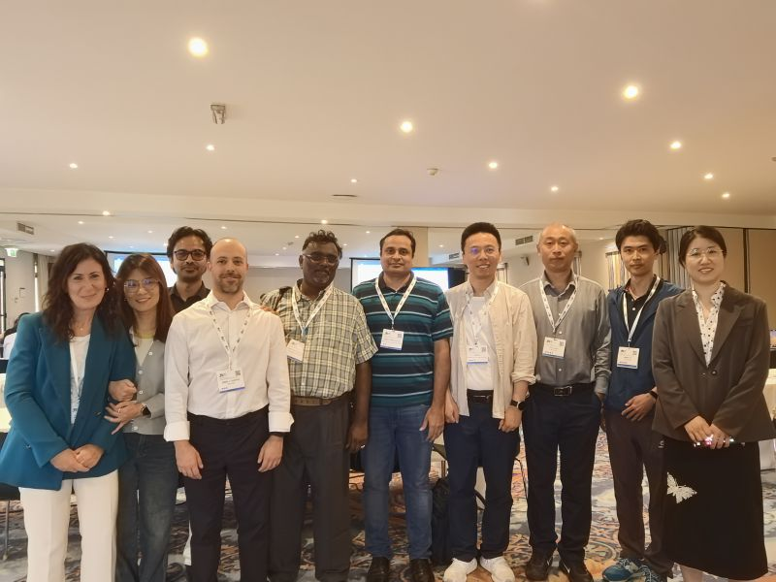
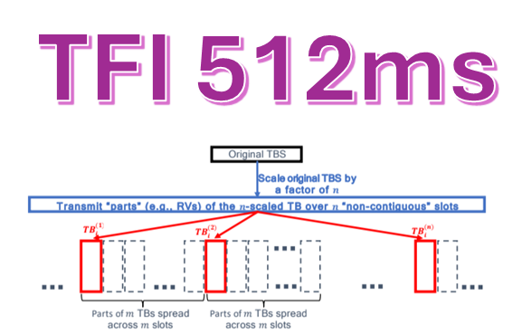
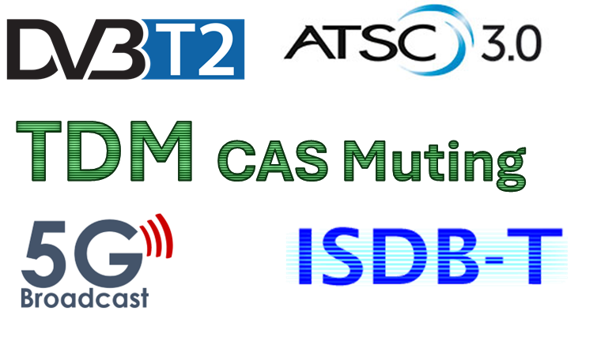

3GPP RAN Defined new Features
For 5G Broadcast for Rel-19 in 2025
3
2

Slide 11
Services: Re-use of existing apps and players
Re-usable components, device-internal interfaces and APIs, combination with advanced unicast technologies
Application Processor
Streaming App
File Download App
IPTV app
Service Discovery
Supported Features
Broadcast only playback
DASH and HLS Support
Seamless BC/UC switching
In-session repair
HTTPS support
DRM Support
Metrics/CMCD reporting
Ad Insertion
Lower Latency
Immersive Content
A/B Watermarking
And and and
I-1
MBMS-APIs
HLOS
MBMS Client
Multimedia System
Streaming Service
File Download Service
Transparent Service
DASH Client
I-4
Local HTTP Server
File
Repair
Reception Reporting
Object Distribution Function
Packet Distribution Function
HTTP/TCP
FLUTE
FEC
Transparent
Service Discovery
I-2
I-3
IP Stack
(unicast)
eMBMS Service
IP Stack
(with multicast)
NR/LTE/WiFi modems
5G Broadcast Feature

Slide 12






Supporting Organizations for Profiles and Services
Qualcomm is engaged in global standardization ecosystem

Slide 13
Status of standards and multi-vendor interop
Modem
Service Layer
Feature complete with Rel-19
Profiling
Launch Profile stabilizing
Middleware and APIs specified
Testing and Interop
Network Interop – First successful plugfest
Device Interop (5G-MAG) in planning
Re-use of existing service layers and apps
ETSI TS 103 720 v1.3.1 expected by Q4/2026

Slide 14
Adoption Path

Slide 15







5G Broadcast -
Ready for launch?
Where: Main IBC Conference Center Room E102
When: Saturday, September 13, 12:15 - 13:00
#FMT

Slide 16

Multi-vendor Interoperability
Infra
vendor
SOC vendor
BNO
Consumer
Johann Mika
CINO @ Big Blue Marble/ORS
Device vendor
Broadcaster
Content Owner

Slide 17


Multi-Player Business Model
Infra
vendor
SOC vendor
BNO
Consumer
Device vendor
Broadcaster
Content Owner
5G Broadcast -
Ready for launch?
Where: Main IBC Conference Center Room E102
When: Saturday, September 13, 12:15 - 13:00

Slide 18
POPULATION COVERAGE PLANNING
EU MARKETS COMBINED
The 5G Broadcast Business Task Force, led by Rohde & Schwarz, has announced its initial deployments in Europe and plans to expand to other regions, such as Brazil.
Content Provider’s customers
78%
5G BC Pop Coverage
OEM Devices
125M*
39,2M**
*
All numbers are assumptions of major BNOs in their countries, based on the precondition of market readiness.
* Numbers for Italy refer to the pre-commercial transmissions started in 2024. No concrete plans yet in Italy.
** Current reports indicate that 40% of all streaming is performed on mobile devices

Slide 19
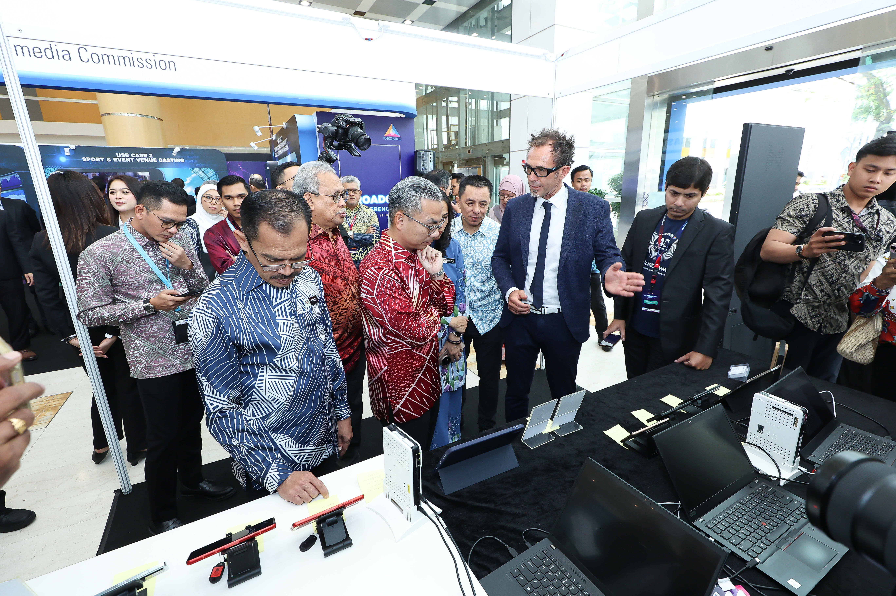
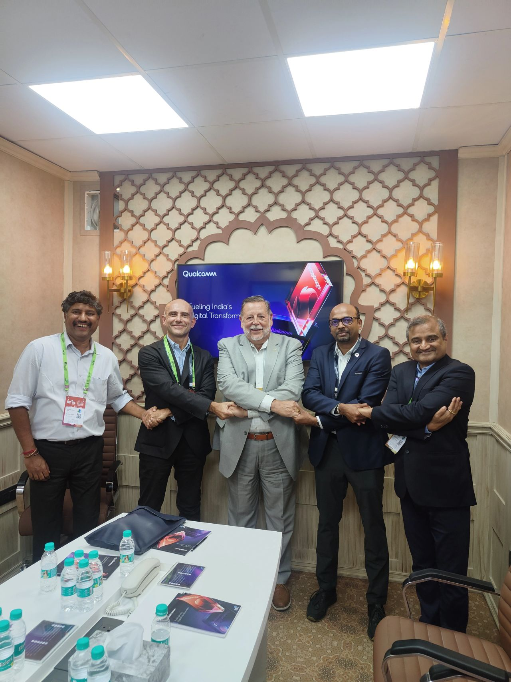
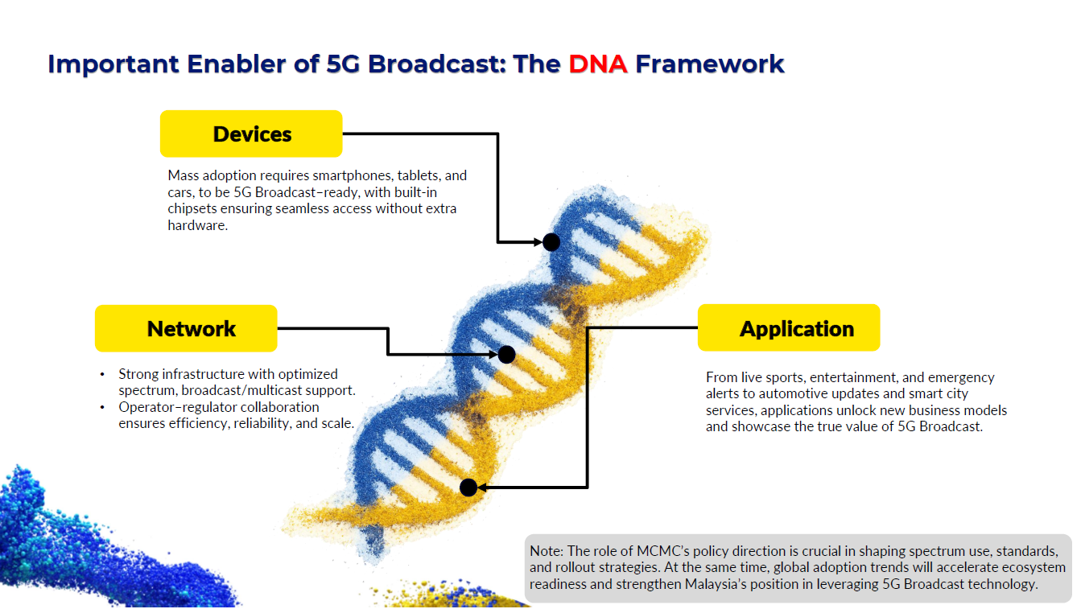
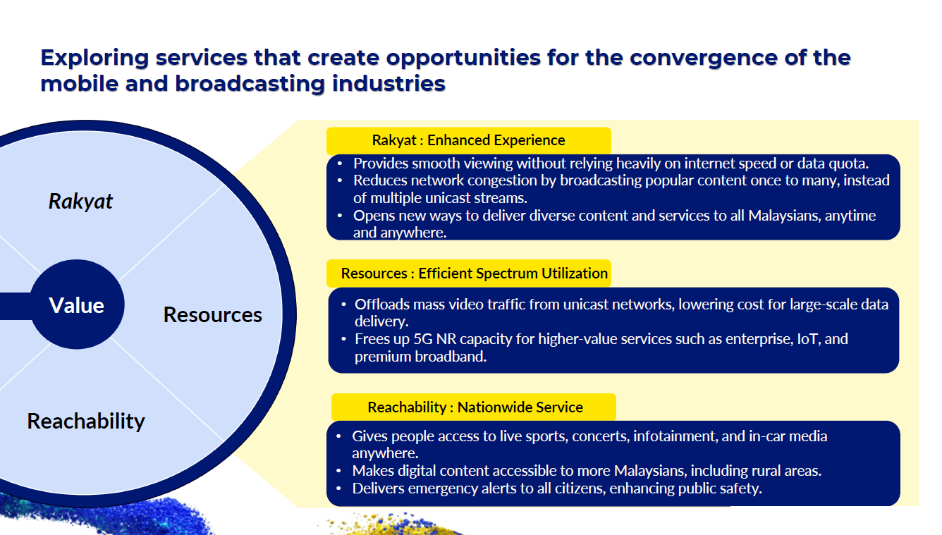
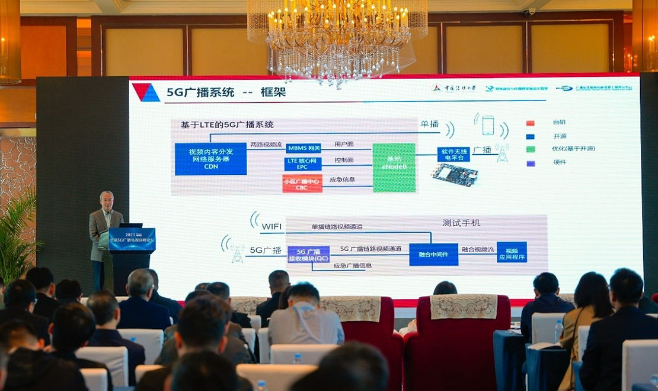
Interop and Ecosystem Updates (2)
Asia – align with European launch efforts for global ecosystem development
Malaysia
  The 5G Broadcast Conference Malaysia completed phase 2 of Malaysian engagement including ASEAN
  Included regulators, BNOs, MNOs, OEMs
  Next step: include MyTV into 5G BC Business TF
India ➔ next slides
China
  Continued and even re-newed interest from ABS
  5G Broadcast Forum Conference in planning

Slide 20
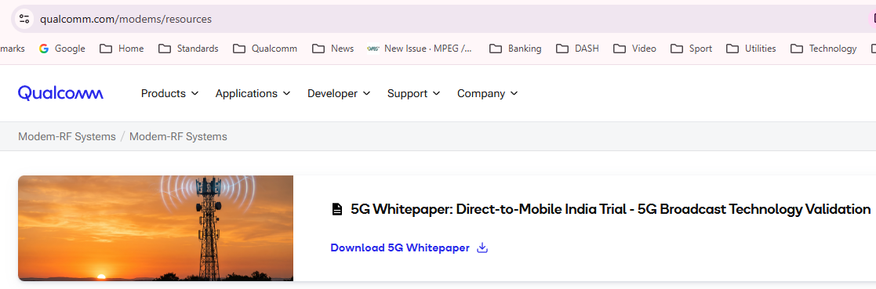

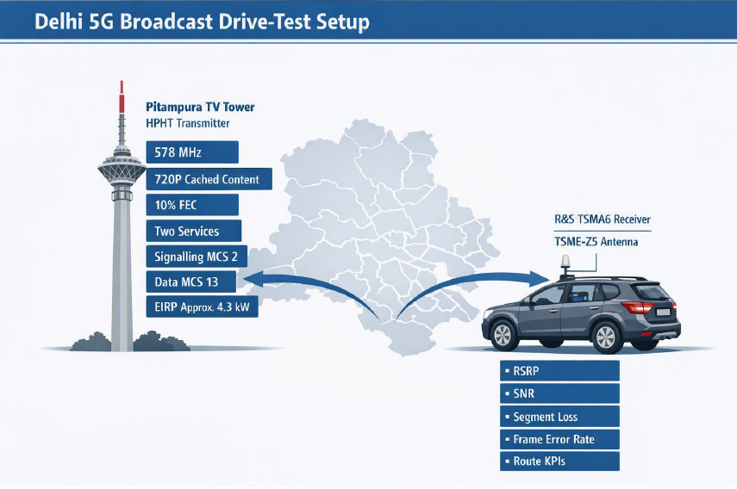
Updates from India
Delhi Trials in Q1/2026
Location: Delhi, India
Duration: Approximately three months
Partners: Prasar Bharati, Reliance Jio, Qualcomm, Motorola, Rohde & Schwarz, Media Broadcast, Sener and Telimart
Network:
  HPHT: Pitampura TV Tower, 578 MHz, approximately 4.6 kW
  LPLT: Rohit House, 570 MHz, 47 W
Services and devices: Two 720p services delivered to smartphones and CPEs
Use cases: Direct-to-mobile reception, broadcast-unicast convergence, public warning and CPE-based delivery to existing devices

Slide 21
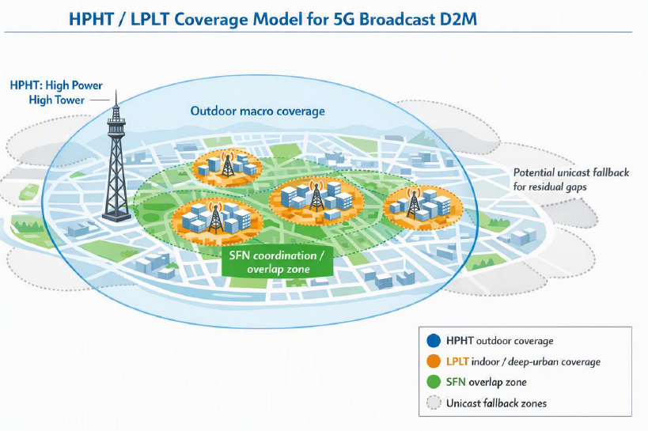
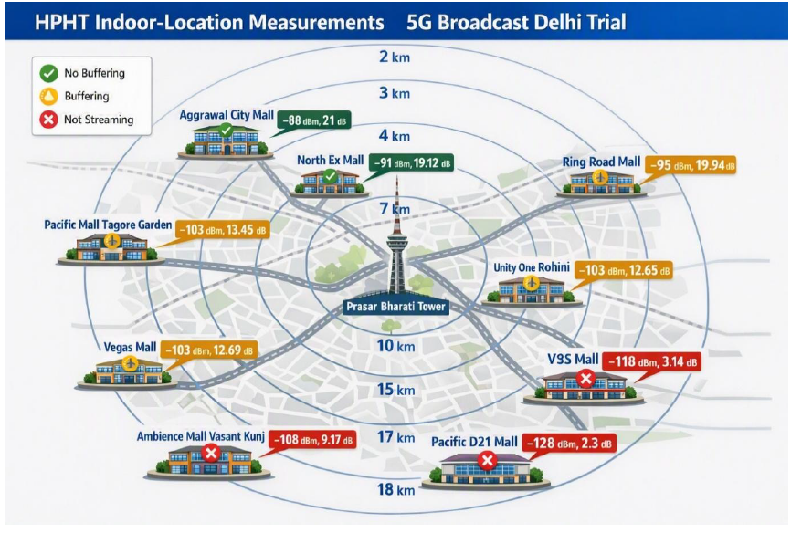
Updates from India (2)
Technical Results and Conclusions
Successful end-to-end operation over both HPHT and LPLT networks
HPHT provides broad outdoor coverage; LPLT can supplement indoor and dense-urban coverage
Coverage depends primarily on SNR, building penetration and local propagation, not distance alone
MCS selection provides a clear robustness-versus-throughput trade-off
Hybrid broadcast and unicast can address residual indoor and coverage gaps
Next step: Extend measurements and planning to determine the scalable HPHT/LPLT network configuration and economics

Slide 22
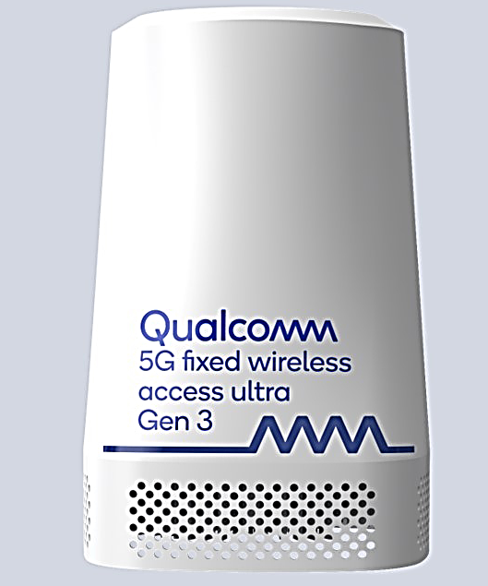
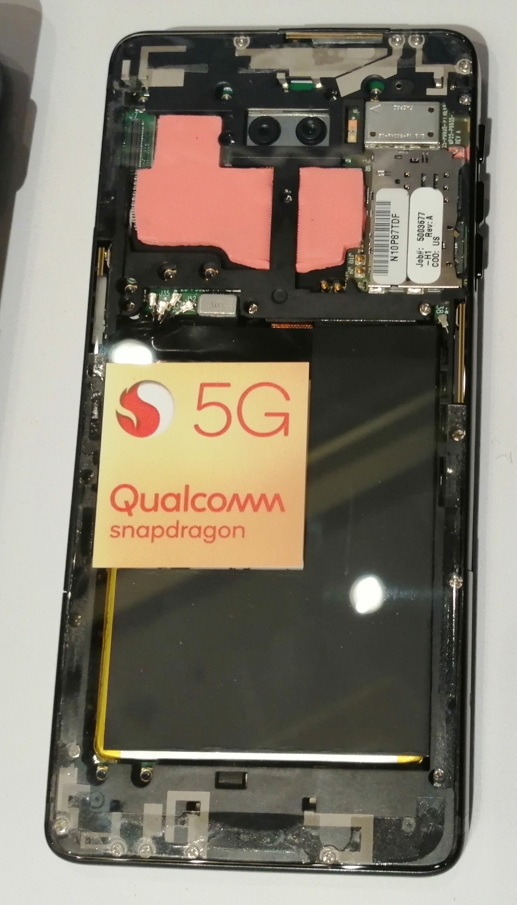
Test platforms
Band 112 (470-608Mhz)
Band 113 (606-698Mhz)
3GPP defined receive-only broadcast bands
Band 108 (470-698Mhz)
Band 107 (612-652Mhz)
550Mhz and higher
n71 (617-698 MHz)
Qualcomm Reference Design
Commercial Reference Design
QRD
CRD
Notes:
In Sept 2023 3GPP defined receive only Band 108 and 107 as broadcast bands which encompass all broadcast UHF channels utilized in Europe and elsewhere
And recently 3GPP defined additional sub bands with the thought that these subbands could help OEMs target certain regions, in the process expediting implementation of such subband in a mobile device.
NEXT
It is likely you came across and even worked on some of these test platforms.
First we have Qualcomm reference designs which are called QRD
We have both mobile and CPE form factors with these devices. These are our standard development platforms where we have more control on HW and SW aspects.
Since we have control on the RF front end we were able to modify the design to add support for higher 500Mhz band on these devices.
NEXT
As the number of partners interested in trialing 5G Broadcast grew we needed to find an alternative to get more devices that could be used for development. For that reason we looked at unlocked onePlus devices that had band71 support which overlaps with Band 107. We received permission from OnePlus and authorize two partners ORS and Rohde Schwarz to enable and distribute OnePlus devices to broadcast partners who could use Band71 for trials. Thanks to this program we were able to get development devices to many partners which we couldn’t help otherwise.
in summary we have QCOM official reference designs which we build in very small quantities with custom parts.
We use these devices to develop and demonstrate a brand new such as unicast+broadcast concurrency which would be missing on CRD devices or OEM devices.
Because of the scarcity of QRD devices we prefer using these devices when CRD devices are not viable to use for the targeted frequency band.
Anywhere else we could use band71 we prefer using CRD devices or OEM models I showed in previous slide as it provides better logistics.

Slide 23
QSIO
Prove the Technology and Build the Ecosystem
QCT
Commercialization and Product Delivery
Historically, 5G Broadcast was driven within QSIO as part of the broader verticals and new-business activities. The focus was on:
Standards development in 3GPP and related organizations.
Global trials and demonstrations.
Ecosystem engagement with broadcasters, regulators, operators, and industry groups such as 5G-MAG, DVB, and others.
Technology evolution, including features such as satellite broadcast adaptation, time-frequency interleaving (TFI), and new broadcast bands.
Defining business opportunities and use cases beyond traditional mobile broadband.
Identifying and validating serious and solidified commercial plans by service and infra partners
QCT support requirements.
Channel estimation and receiver implementation issues.
Product roadmap priorities.
Deployment assumptions and system-layer details.
Integration with unicast modem operation
Detailed testing with main infra
Frequency planning
Commercial status
ecosystem has largely accepted the technical feasibility of 5G Broadcast
commercialization discussions have become increasingly important

Slide 24
The core idea about handhelds for 5G Broadcast is the full integration of the modem with commercially large scale SOCs, such as those available in flagship devices from large OEMs. This makes 5G Broadcast a modem feature.
3GPP defines many features in each Release and a modem can only support a small subset, so features (and their detailed parameters) are selected by commercial needs and implementation complexity, area costs, etc.
5G Broadcast is defined such that the latter (implementation costs) are minimized by making the technology hardware-compatible with existing SoCs.
Acknowledging solidified plans from BNOs to start services in 2027, 5GB is a seriously considered feature (a "contender") for upcoming modems and scoping of the feature has started (identifying exact implementation requirements and costs).
Start of scoping is a result from consolidating business opportunities around the world. Moving forward, the process will continue by consolidating implementation requirements and business opportunities - in particular for OEMs to support the feature on their devices.
Anticipating leading Android OEMs to be in market with H1/2028 models, Qualcomm plans to support OEMs to meet their commercialization goals.
(Test devices Q2/2027)
Typically, a major feature like 5GB arrives to flagship devices and waterfalls to lower tiers gradually. Anticipating SOCs for other form factors such as CPE, compute, automotive to follow in a waterfall fashion
The features to be added beyond what is already in the modem are primarily "receive-only", new frequency bands, new carrier bandwidths, concurrency with unicast, otherwise re-use.
We are on track on making 5G Broadcast a reality and attractive to Service Providers and OEMs. Standards/Engineering focus now on implementation support of scoped features: test transmitters, test cases, etc.

Slide 26
General technology introduction
5G broadcast and 3GPP
“5G broadcast” is a broadcasting standard defined by 3GPP (Release 16 - 2020)
  3GPP is the industry group responsible for defining global cellular tech standards (e.g. 4G / 5G)
  In the last few years 3GPP has expanded to new verticals (e.g. broadcast, automotive, satellite, etc.) hence it should not be regarded as a surprise that a broadcasting tech is coming out of 3GPP
Even though 5G Broadcast has been standardized by 3GPP, it is a broadcasting technology
  I.e. meant to be used by broadcasting operators, in broadcasting spectrum
  No need of supporting a unicast network. 5G Broadcast does not have anything to do with unicast
The main design target & “reason for being” of 5G broadcast is to enable operation of a broadcast network where the receivers are hardware-compatible with cellular modems
  “Hardware compatible” means lower barrier to adoption in mobile devices compared to other broadcasting technologies
    This is because several 5G Broadcast building blocks are already there in a 4G/5G modem, hence the additions are marginal.
    For other technologies, a separate piece of silicon / die area would be required
  To be clear, 5G Broadcast has nothing to do with “cellular operators trying to take over from broadcasters”

Slide 27
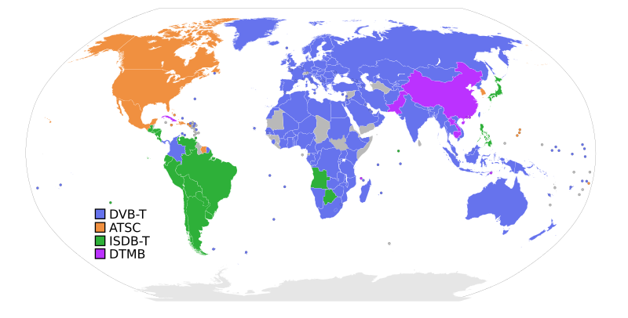

5G Broadcast and other radio technologies
Cellular and
5G Broadcast
Converged –
Apps and Devices
5G Broadcast is generally not expected to be deployed as greenfield or as standalone technology
Internet
Linear TV
Radio
Cellular Modem
UHF band support
Technical aspects and opportunities of co-existence presented in the following
Notes:
Motivation
However, when introducing a new broadcast technology, the co-existence with and the migration from existing broadcast technologies is one of the most challenging efforts – also taking into account spectrum scarcity, the need to support legacy receivers, and regulatory constraints.
Secondly, in the modern world of apps and software-based service layers, there exists a huge opportunity to share service layers across transport technologies including stationary and cellular unicast delivery, providing a unified and enhanced user experience. As 5G broadcast is decoupled from a specific service layer, unique and exciting co-existence scenarios exist.
A third aspect is the deployment of 5G Broadcast jointly with unicast, including initial discussions on spectrum and technology requirements.

Slide 28
#1 Sharing UHF Resources with legacy broadcast systems
Frequency Division Multiplex (FDM) on different carriers or Time Division Multiplex (TDM) on the same carrier
min_time_to_next = [50ms; 5300ms]
ATSC3.0 supports blanking
Bootstrap | Preamble | ATSC Frame |  | Bootstrap | Preamble | ATSC Frame
DVB-T2 support Future Extension Frames
1st FEF frame
(up to 250 ms T2-Base / 1s T2-Lite)
1st DVB-T2 frame
2nd DVB-T2 frame
P1
P2
# 0
Data
# 0
Data
# 1
Data
# 3
P1
FEF Data
P1
P2
# 0
Data
# 0
Data
# 1
Data
# 3
P1
FEF Data
FEF frame starting with P1 symbol
Rel-19 now supports CAS muting
5GB
CAS-muted region
CAS
PMCH
# 0
PMCH
# 1
…
CAS
CAS-muted region
CAS
PMCH
# 0
…
SIB-indication

Slide 29
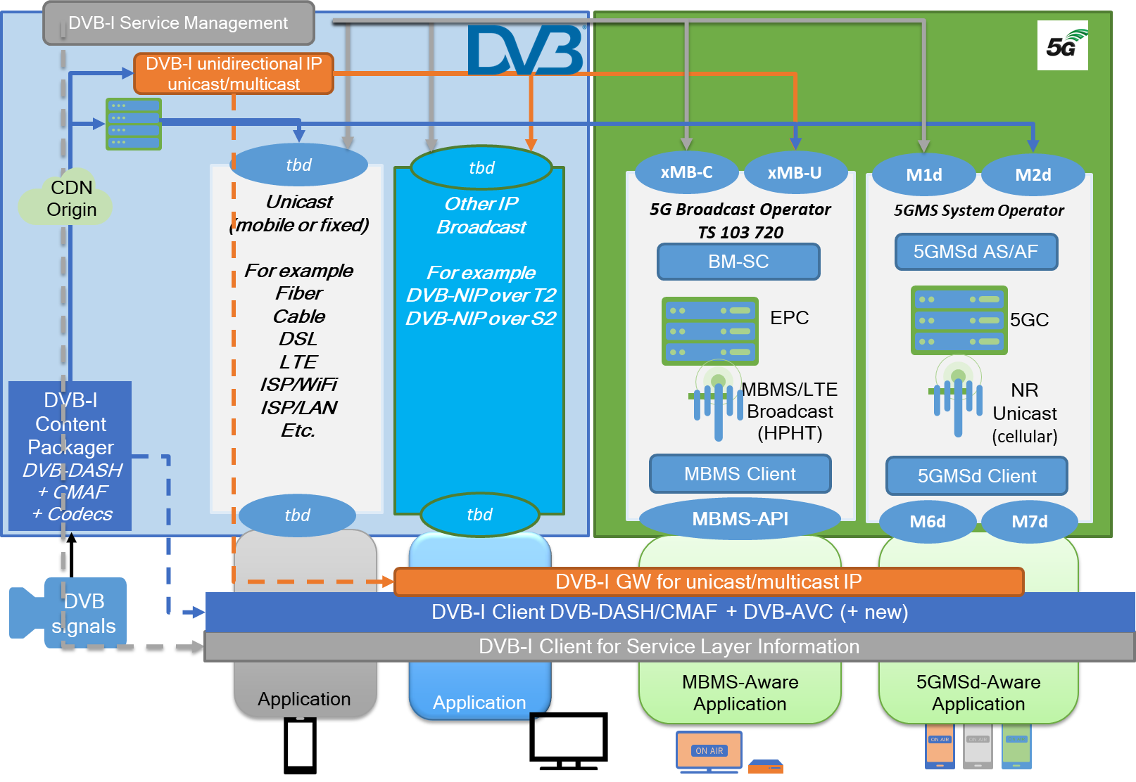
#2: Unified Service Layer
5G Broadcast as transport-only technology can be integrated into existing service layers and apps => DVB-I + 5G Broadcast
Vision: DVB Service Layer (Codecs, Packaging, DRM, Service Announcement and Discovery, IP-based protocols) runs on top of any transport network, in particular 5G Unicast and 5G Broadcast
ETSI TR 103 972 (07/23): Deployment Guidelines for DVB-I services over 5G Systems ➔ mostly plug and play leveraging DVB-I and 5G Broadcast APIs and reference points (see figure on the right-hand side)
specs completed in 3GPP, DVB, 5G-MAG, ETSI
Successful over-the-air demonstrations in 2024:
  DVB World (03/24): standalone DVB-I list over 5G Broadcast
  Media Web symposium (06/24): integrated into German DVB-I Pilot list as one service instance, fallback to unicast if out of coverage
  IBC 2024 at DVB booth and also shown at MWS
Similar efforts started for ATSC3.0 integration

Slide 30
#3: 5G Broadcast combined with cellular unicast
5G Broadcast is expected to be available as a new feature in mainstream mobile devices w/o comprising existing features
TV Application/Service Provider
Technical Enablers
  5G Broadcast (as a fully defined 3GPP technology) allows the coordination of frequency bands in uplink and downlink, and the concurrent processing of broadcast and unicast spectrum in same modem.
  Current commercial 3GPP modems already support simultaneous operation in multiple bands (dual-SIM and dual connectivity)
    Concurrent operation of 5G Broadcast and unicast is realized by leveraging the same mechanisms
    difference that one of the bands is a receive-only broadcast band (UHF is 3GPP Band 108).
Selected Opportunities
  Seamless coverage extension with unicast fallback (indoor, rural, etc.)
  Broadcast-on-demand: consumption and QoE metrics reporting allow a user-centric allocation of radio resources to specific programs
  User-targeted features: interactivity, DRM-protected content, targeted ads, personalization, accessibility, advanced media capabilities (HDR, VR, etc.)
  Re-use of existing apps – 5G Broadcast is a transport-only technology and supports improved quality, cost efficiency, and reliability.
  More rapid development and deployments (upgrades, app systems, etc.)
Internet
Broadcast
High Power
High Tower
Cellular Modem
Cellular unicast
5G broadcast
TV/Media Application

