Slide 1
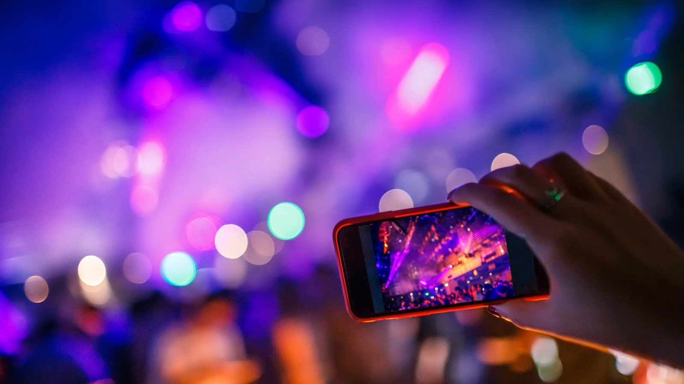
Is AI finally democratizing TV?
DVB@IBC 2026
September 13, 2026
@qualcomm_tech
Dr. Thomas Stockhammer
Senior Director Technical Standards
Qualcomm Technologies

Slide 2
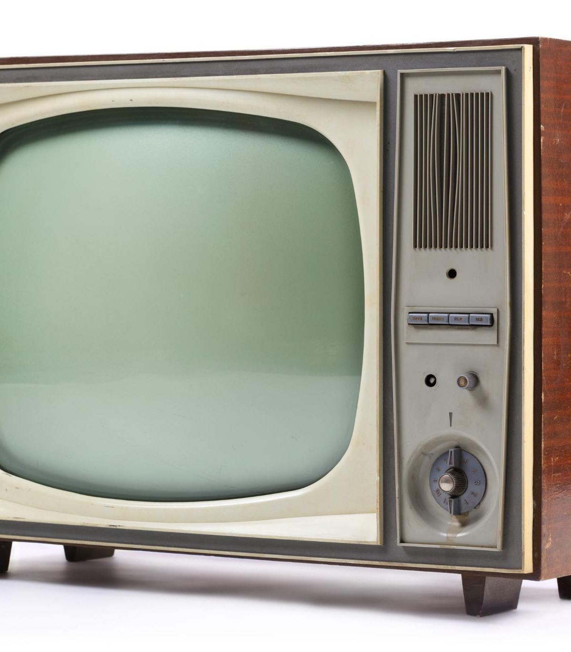
The Development of Television (1930s–1980s) and Its Historical Influence
Television's growth shaped society and culture profoundly
Notes:
---

Slide 3
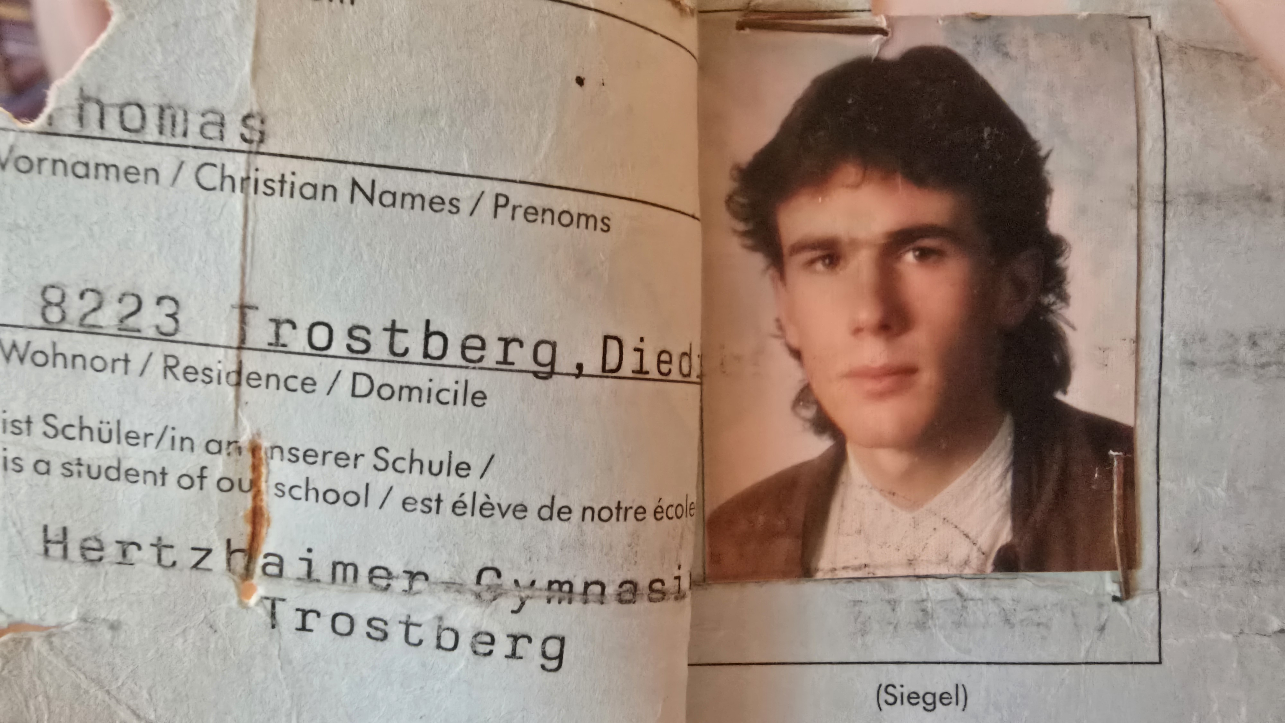
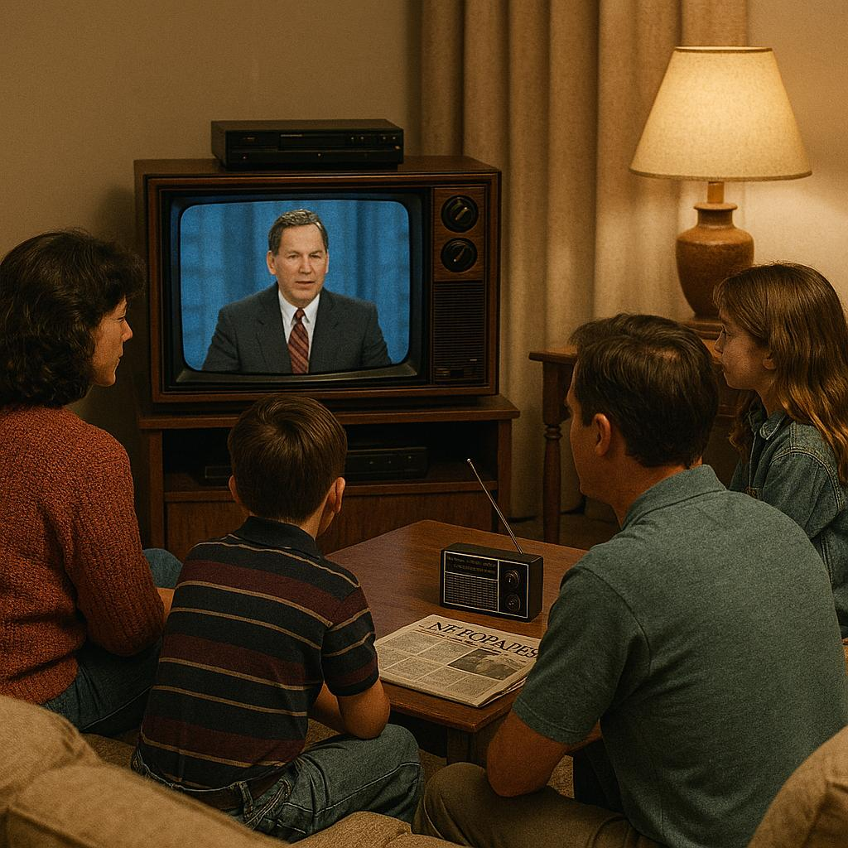

TV and Media in the 80s and 90s: only 40 years ago
Linear, dedicated access and distribution, professonally produced, domestic, FTA
TV
Broadcaster
Radio
Broadcaster
News Publisher

Slide 4
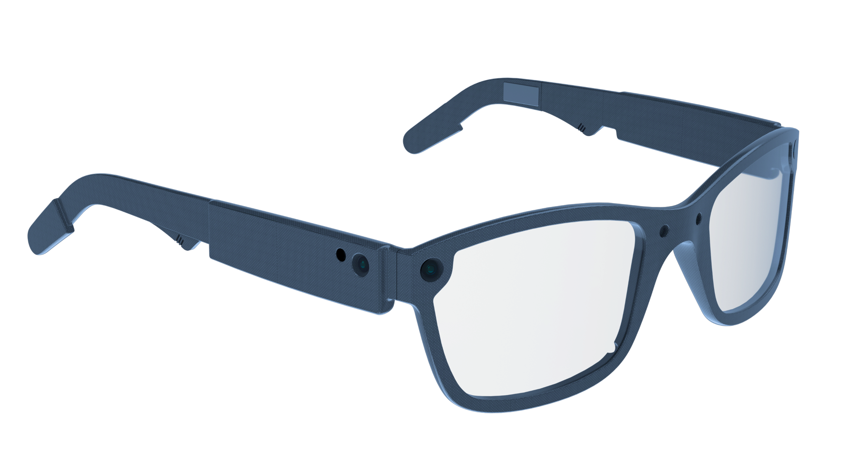
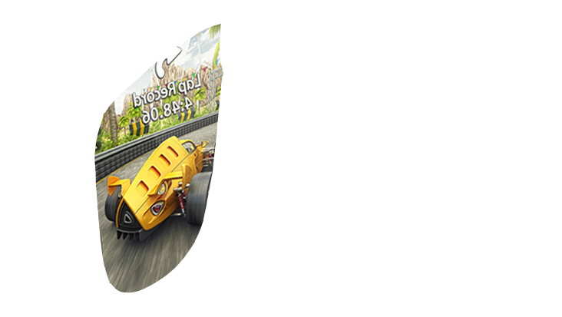

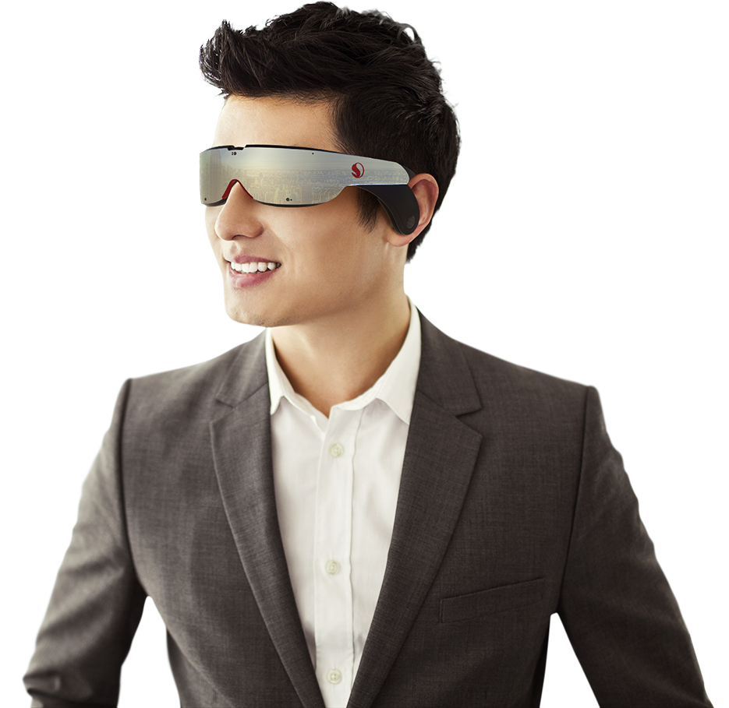
The new world of Media and Broadcasters: Devices, Formats, Users
UHD/8K
Social
3D/Volumetric
Immersive
Personalized
Interactive
Gaming-like
Short & long
Live
On-Demand
User Generated
AI-supported
Location
Global
Secure
Time-shift
Trusted
…
User-Generated Content and Social Media
Internet
Cloud/Edge
Broadcasters
and Content Provider
Cellular
WiFi
Quality
Cost
Scalability

Slide 5



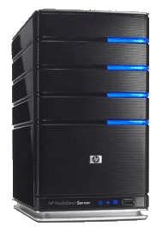


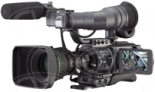


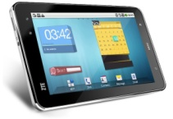
Content Delivery Protocol – Adaptive HTTP Streaming
Encode each media type at multiple bitrates => track
Make each segment addressable via an
HTTP-URL
Client makes decision on which segment to download
Client acquires a license for encrypted content
1
4
5
6
Manifest
Timeline
Resource Addresses HTTP
Codecs
Variants
DRM Server license
Operational information
2
Split each track into small segments
7
Client splices and synchronizes for play back
CDNs
Clients
001010100001010
010101010001110
01110100011010101
001010100001010
010101010001110
01110100011010101
001010100001010
010101010001110
01110100011010101
001010100001010
010101010001110
01110100011010101
3
Encrypt each segment
Media Capture
and Encoding
DRM Encryption
Server
Media
Origin
Servers
HTTP/S
Cache
Servers
Client
Devices
DRM
License
Server

Slide 6
We have technically democratized TV
… but it is for a the better or the worse?

Slide 7
Trends resulting from the new technology enablers
6. Targeting & Addressable Advertising
Ads delivered at household level using data
Enables precision segmentation + personalization
Increasing adoption across advertisers
👉 Shift: Broadcast → Data-driven targeting
7. Short‑Form Video Disruption
~63% of users consume short-form video daily
Strong shift among younger audiences
👉 Shift: Long-form viewing → Snackable formats
8. Search & Recommendation‑Driven Consumption
Content discovery increasingly algorithm-driven, not schedule or channel-based
Platforms use AI/behavioral data to surface content
Short-form and streaming platforms excel at predictive recommendations
9. Device Shift: TV Screen No Longer Dominant
Strong growth of mobile and multi-device viewing
Smartphones account for a large share of streaming usage
👉 Shift: Living room TV → Multi-screen / mobile-first
10. Sports Rights Transformation
Sports used as key driver for streaming subscriptions
Complemented by short-form highlights and social distribution
👉 Shift: Broadcast monopoly → Multi-platform ecosystem
TikTok/Shorts drive algorithmic content discovery
👉 Shift: Browsing channels → Being “served” content
Social/short-form platforms become “new TV screens” for younger users
Increasing shift of rights to streaming platforms
1. Linear → Streaming / On‑Demand
👉 Shift: Schedule → User control
2. Cord‑Cutting & OTT Dominance
Pay TV penetration fell from ~88% to <50%
Streaming now exceeds combined cable + broadcast viewing
3. Explosion of On‑Demand & Subscriptions
VoD market growing ~10–11% CAGR globally
👉 Shift: Scarcity → Infinite library
4. Hybrid Monetization Models
Rise of AVOD + SVOD combinations
👉 Shift: Pure models → Hybrid revenue stacks
5. Advertising: Linear → CTV / Digital Video
Digital video ad spend exceeds linear TV (~2024)
👉 Shift: Mass reach → Measurable digital TV
~45–47% of TV time now streaming vs. declining broadcast/cableViewer control replaces fixed programming schedules
~80M+ households moving to non‑pay TV [wifitalents.com]
👉 Shift: Bundled distribution → Internet delivery
Households subscribe to multiple platforms (2–4 typical)
Content becomes always available across devices
Majority of viewing still ad-supported (~70%+)
Subscription fatigue drives lower-cost ad tiers
Linear TV ad spend down ~27% over decade
Growth in connected TV (CTV) and OTT advertising
Streaming surpassed linear TV viewing (~2025)

Slide 8
But we actually created even more monopoly – the FAANGs!
… so let‘s do more …
AI may change everything!

Slide 9
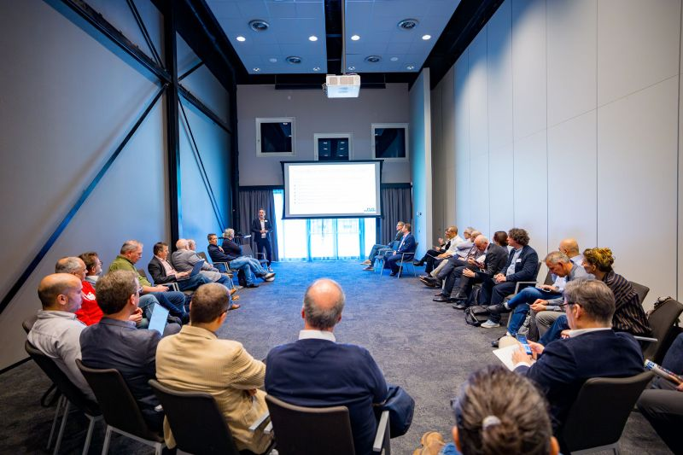
Goal: An open content platform
A global open platform that performs five core functions:
  Ingest media from creators (UCG and professional, live and on-demand)
  Process & store media at massive scale
  Distribute video efficiently to viewers worldwide
  Discover & recommend relevant content
  Monetize & govern content (for example including public media fees)
All of this is built with based on European values and regulations, is open, is built on standards potentially from DVB and related orgs
DVB has technologies in this domains

Slide 10






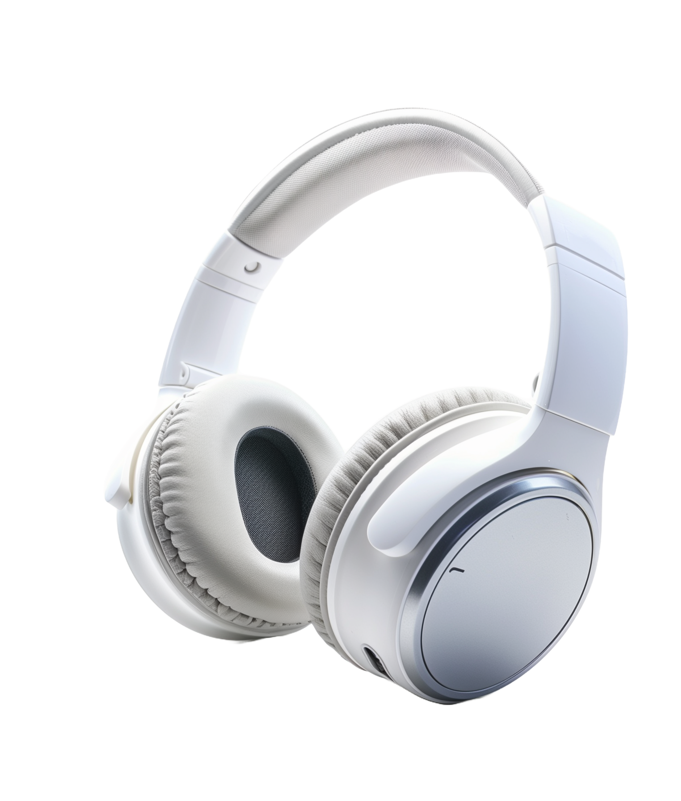
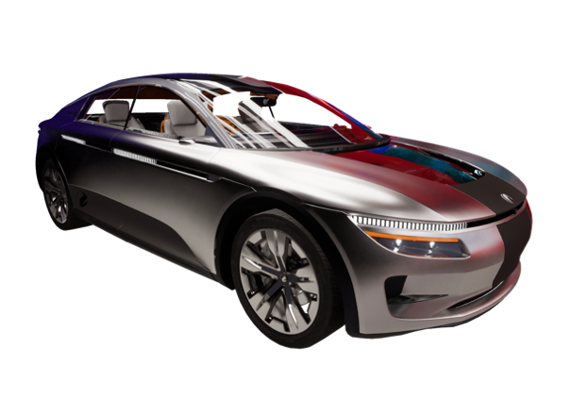







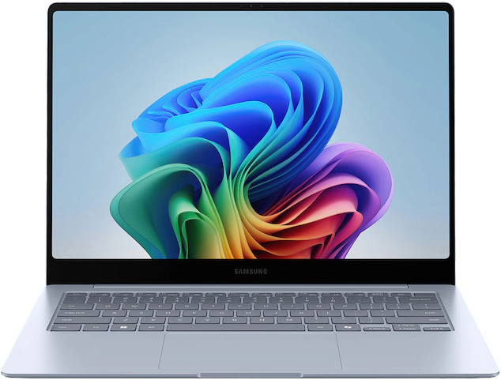
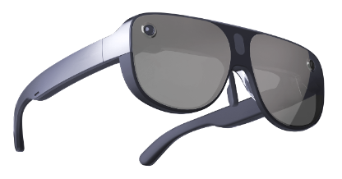
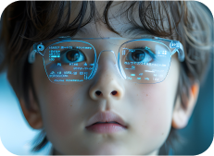
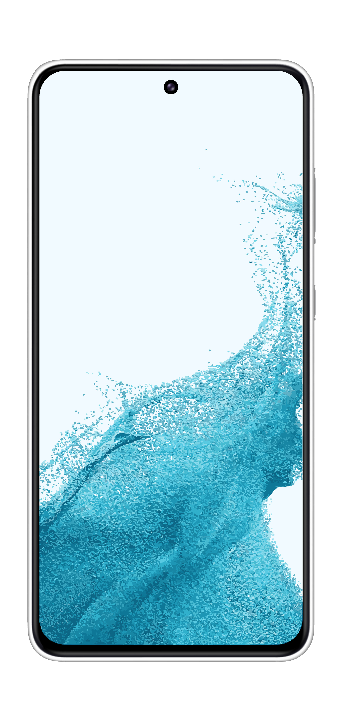


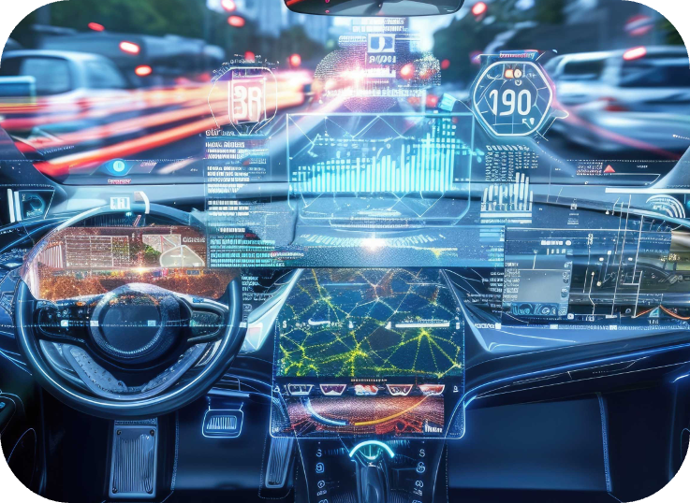

AI is the new UI
On-device
Voice/audio
LMM - multimodal
Entertainment
Text/touch
Commerce
LLM - language
LVM - vision
Health
Photo
ASR
Concierge
AI Agent
Vision
Navigation
Messaging/
social feeds
Sensors

Slide 11

DVB-I service discovery and curated service lists
Editorial metadata, schedules and content descriptions
Consistent service and application entry points
DVB-DASH delivery with codecs and DRM
Hybrid broadcast and broadband access
Open specifications and interoperability
Natural-language and multimodal search
Personalized recommendations across services
User-controlled preference profiles
On-device ranking, summarization and conversational navigation
Cross-service discovery without exporting detailed behavioral histories
Controls to inspect, reset or disable personalization
Trusted media

