Slide 1


From 5G Media Streaming to 6G Media Delivery: Lessons Learned and Future Directions in 3GPP
Thomas Stockhammer¹, Frédéric Gabin², Jordi Gimenez³, Daniel Silhavy⁴, Richard Bradbury⁵ and Julien Lemontheux⁶
¹ Qualcomm Germany GmbH, Munich, Germany
² Dolby Labs, Paris, France
³ 5G-MAG, Geneva, Switzerland
⁴ Fraunhofer FOKUS, Berlin, Germany
⁵ BBC, London, United Kingdom
⁶ Orange, Rennes, France

Slide 2
From 5GMS Deployment Lessons to 6G Media Delivery
5GMS foundation and deployment lessons
Reference Tools and Implementation lessons
Rel-20 Advanced Media Delivery Phase 2 & Energy-awareness
Evolution toward 6G

Slide 3
3GPP SA4: multimedia codecs, systems and services
Four specialized sub-working groups develop the technical building blocks for end-to-end media experiences
SA4
End-to-end media specifications
Audio SWG
Video SWG
MBS SWG
RTC SWG
Speech and audio
Video and visual media
Media delivery
Real-time communication
Speech and audio codecs
Audio quality and performance
Terminal acoustic requirements
Video codecs and formats
Visual quality assessment
Immersive and emerging visual media
Streaming and broadcast systems
Media transport and distribution
QoE, network assistance and delivery efficiency
IMS multimedia telephony
WebRTC-based communication
Real-time media transport and adaptation
SWG = Sub-Working Group | Scope summarized from current SA4 organization and work programme
1

Slide 4
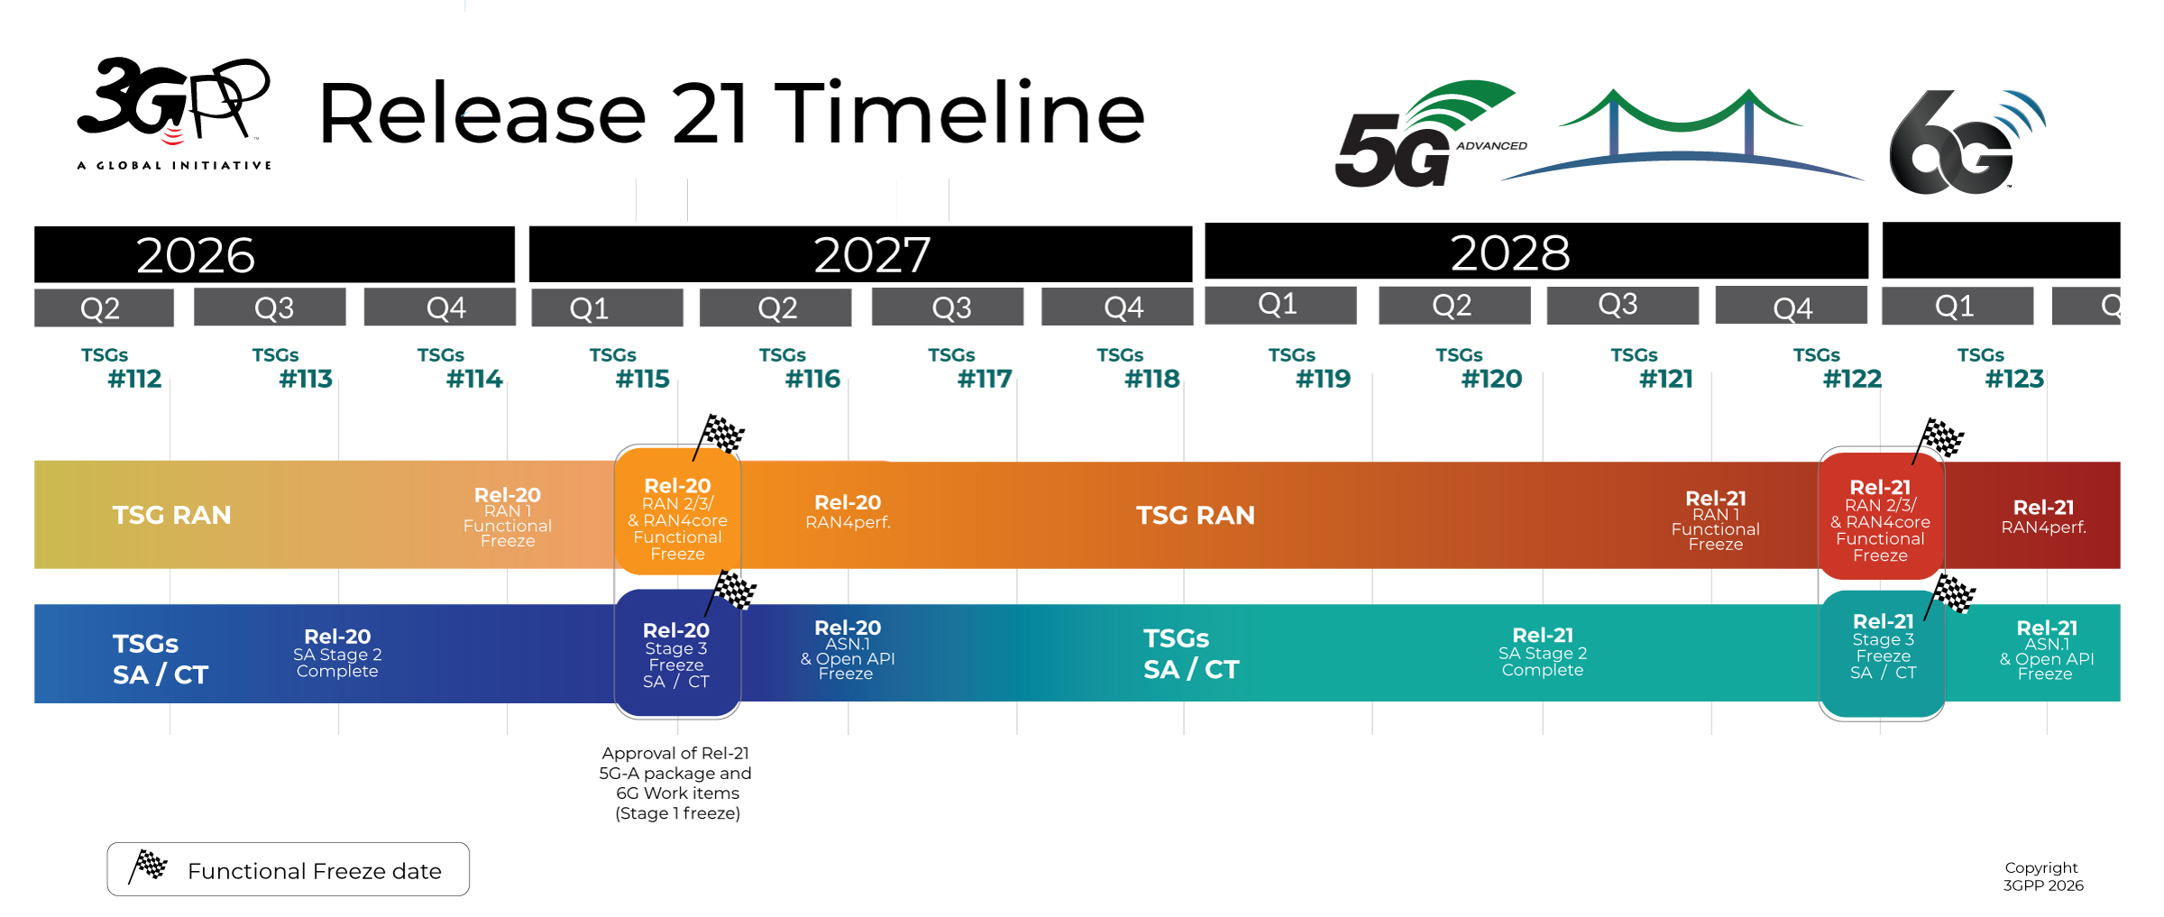


Release Timelines
Release 21:
1st set of 3GPP 6G technical specifications and IMT-2030 submission, expected to be delivered with a single drop (i.e., a single code freeze).
Rel-21 timeline was decided in June 2026
ASN.1/OpenAPI freeze date is no earlier than March 2029

Slide 5
Rel-16 5G Media Streaming – The Idea
Collaboration of MNOs and Media Service Providers
Approach:
  Framework aligned with today‘s OTTmedia distribution practices
  The application keeps standard HTTP adaptive-streaming formats and CDN integration while using optional network capabilities through the service layer.
  Aligned with the 5G System architecture concepts – service-based architecture, QoS, etc.

Slide 6





5G-MAG Reference Tools: Bridging Standards and Practice
MESSAGE 3GPP defines the architecture and interfaces; 5G-MAG provides the common environment to implement and validate it.
Classification
Open source
Client side
5GMS-Aware Application
Media Session Handler
Media Stream Handler
Media Player
integration libraries
Server and service side
Application Provider portal
5GMS AF
5GMS AS
QoE metrics dashboard
Deployment and learning
examples
tutorials
Docker setups
lab and trial environments
WHERE TO START clone the client and server components, run the Docker setups, then extend them feature by feature
https//5g-mag.com/tech/5gms
Notes:
MANDATORY. Target 45 seconds.
Primary visual is Figure 3 of the paper. Place the three short labels above the figure. Include the 5G-MAG technical resources link.

Slide 7
Early 5GMS Features
Primarily downlink features introduced in the first 5G Media Streaming releases
Content Hosting
Downlink media streaming with pull- and push-based content ingest
Dynamic Policies
Policy templates instantiated and provisioned through the PCF
Network Assistance
AF-based and ANBR-based assistance towards the client and the RAN
Consumption Reporting
Client consumption reports provisioned to the Application Provider
Metrics Reporting
AF-, RAN- and OAM-based QoE metrics collection and provisioning
Also in the early releases
Service URLs for media entry points
Data collection, reporting and exposure framework
Common client and server side procedures

Slide 8





AMD Phase 1 - The Initial Toolbox
From Rel-19 onwards consistent feature-based extensions
3GPP Work on «Advanced Media Delivery» completed and published (TS 26.501/502/510/512/346/517 – December 2025)
Selected features
  Distributing Encrypted and High-Value Content ➔ standard DRM workflow
  In-Session Unicast Repair for MBS/MBMS Object Distribution ➔ relevant for 5G Broadcast
  Improved QoS Support for Media Streaming ➔ usage of ECN and L4S
  Common Media Client Data (CMCD) ➔ more details in phase 2
  Media Delivery from Multiple Service Endpoints/Locations* ➔ next slides

Slide 9


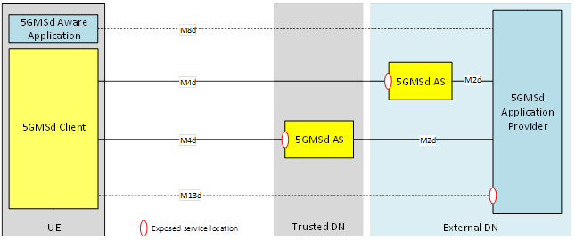

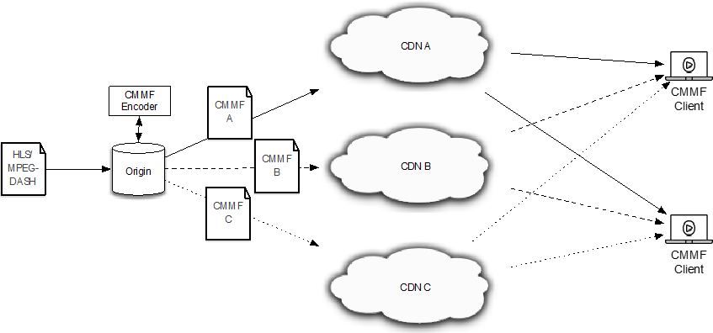
Media Delivery from Multiple Service Endpoints
WHY A single media session can transparently use several delivery resources, improving scalability, resilience, latency and resource efficiency while keeping one unified service experience.
Classification
5GMS Rel-19
Switch between sources
Sequential selection and failover
Content Steering for DASH
ETSI TS 103 998
Resilience and continuity when a source degrades
Stream concurrently
Simultaneous retrieval from several sources
Coded Multisource Media Format (CMMF)
ETSI TS 103 973
Higher throughput and efficiency by combining sources
ENTRY Multiple service locations are declared in the Media Player Entry, e.g. the MPD.

Slide 10


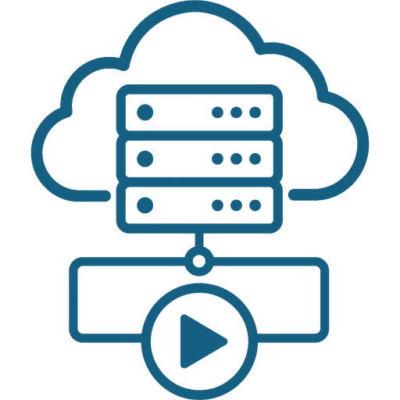


Rel-20 AMD Phase 2 & Energy-awareness
WORK IN PROGRESS Specification work is ongoing in 3GPP SA4, with completion expected in mid-2027.
System-independent deployment
Expanded in-band client metadata
Latency measurement and control
Network- and server-assisted streaming
Multi-access and multi-network delivery
Converged unicast and multicast/broadcast delivery
Energy-aware media delivery

Slide 11

System-Independent Deployment: One Media Layer, Many Systems
KEY IDEA The media service layer stays the same; only the underlying system capabilities change.
Classification
Portable core
Stable media layer
Reusable across systems
Media Client, Media AS, Media AF
service access and reporting
application-controlled adaptation
Explicit dependencies
Stated, not implied
what the media layer needs
equivalent capability elsewhere
no hidden system assumptions
Underlying system
Replaceable part
access network and transport
policy and traffic management
capability exposure
WHY IT MATTERS Media functions proven in 5GMS stay reusable as the underlying system evolves towards 6G.
Detailed view a dedicated slide later in the deck breaks the two layers apart function by function.
Notes:
Set up the system-independent idea before the feature walk-through. Target 45 seconds.

Slide 12
Which Media Functions Depend on the 5G System?
IDEA 5G Media Streaming does not require the 5G System. Most of it is application and media functionality; a few features need a capability that some underlying network has to supply.
Portable
Runs over ordinary IP, CDNs, Wi-Fi, broadband or enterprise networks
Content hosting and preparation
Media delivery
Content publishing
Service URLs and deep links
Formats, profiles and codecs
Conditionally portable
Needs an equivalent capability from the underlying network
Network assistance
Dynamic policies
QoE and consumption reporting
Data collection and exposure
Edge processing
Separate assessment
Relies on system-specific delivery architectures
Multicast and broadcast delivery
Hybrid unicast and broadcast
Slice awareness and analytics
EXAMPLES the same generic capabilities exist in other systems
Generic capability
5G
4G
Wi-Fi / Fixed
Traffic Management Function
UPF
P-GW / PCEF
WMM, CMTS, BNG
Network Policy Function
PCF
PCRF
PCMM, BPCF
Capability Exposure Function
NEF
SCEF
API gateway, ALTO
Access Network
NG-RAN
E-UTRAN
Wi-Fi AP, DSL, cable
These generic names are informative abstractions used to describe dependency; they do not define new 3GPP functions.
Most media functions are portable. Only policy, traffic management, exposure, access and broadcast delivery depend on the underlying network.
Notes:
The underlying-network terms TMF, NPF, CEF and AN are abstractions used to express feature dependencies. They do not define new 3GPP network functions, new architecture or new normative reference points. The existing Media Client, Media AS and Media AF stay unchanged. Equivalent capabilities in different networks do not necessarily provide identical behaviour. Target 60 seconds.

Slide 13
The Media Player Is the Best Sensor of User Experience
WHY Packet and server observations alone cannot fully reconstruct the player’s current experience.
Classification
Portable
Media Player
Knows the state that matters
buffer state
playback rate
selected representation
throughput estimate
live latency
error and response info
5GMS AS / CDN
Sees every request anyway
receives client context with the request
logs and correlates it per session
feeds delivery and steering decisions
M4d – ordinary HTTP request
CMCD key–value pairs in the header or query string
HOW Include selected client context in ordinary HTTP media requests.
IN THE 5G-MAG REFERENCE TOOLS extend the Media Player to collect and emit CMCD on M4d requests, and add a collector at the 5GMS AS that logs and correlates the keys per session.
Notes:
SKIP CANDIDATE (optional). Target 30 seconds.
Build instructions:
- Reuse the simple CMCD request graphic from Slide 10 of Stockhammer-IBC.pptx.
- Add to the player box: buffer state, playback rate, selected representation, throughput estimate, live latency, error and response information.
- Why: packet and server observations alone cannot fully reconstruct the player experience.
- How: include selected client context in ordinary HTTP media requests.
- 5G-MAG footer: available baseline is CMCD generation in media requests, collected at the 5GMS AS.
- Classification: Portable.

Slide 14



Client Metadata: From CMCD to Actionable Delivery Insight
WHY The player knows playback conditions that cannot be reconstructed from network traffic or server logs alone.
Classification
Portable core
Media Player
buffer and playback state
selected representation
throughput estimate
5GMS AS / CDN
validation and filtering
normalisation, aggregation
5GMS AF
session correlation
selected information
Analytics consumer
authorised exposure only
M4d
M3d
Authorised
Observe
Detect low buffer, errors or emerging playback problems
Diagnose
Correlate player behaviour with requests and service locations
Optimise
Inform delivery, caching, steering or policy decisions
IN THE 5G-MAG REFERENCE TOOLS CMCD generation and logging already exists; the implementation work is AF-side aggregation, session correlation and an authorised exposure API.
Notes:
MANDATORY.
Spoken narrative: “The first feature is client metadata. Release 19 introduced CMCD into 5G Media Streaming, allowing the player to attach information such as buffer state, playback rate, selected representation and throughput estimates to ordinary media requests. Phase 2 generalises this into a more complete operational data path. It adds latency, error and operational information, configuration options, server-side processing, session correlation and controlled exposure. The important point is that the basic mechanism remains ordinary in-band HTTP signalling. It therefore works across delivery environments, while 5G-specific policy or analytics functions can use the information when available.”
This slide consolidates the former two-slide sequence (CMCD motivation + extended architecture) into one.
Backup slide to prepare: “Client Metadata: Detailed Configuration and Processing Flow” using the SA4#137-e client-data sequence diagram.

Slide 15

Measure Latency Against a Common Reference
WHY Latency measurement is an observability feature: without it, neither the application nor the network can tell why latency increased, or how to reduce it without hurting playback stability.
Classification
Mostly portable
Encoder / Packager
media timing metadata
manifest generation
producer reference time
Origin / CDN
delivery of segments
5GMS AS boundary
segment availability timing
Media Player
presentation state
target latency and bounds
measured presentation latency
Reporting server
M4d and M13d reports
client–server correlation
aggregation across sessions
Common time reference a shared time-sync server anchors encoder, origin and player to the same clock
ENABLES Locate where delay is introduced, compare delivery paths and service locations, and tune buffering and endpoint selection — usable for live optimisation and for after-the-fact diagnostics, as on the previous slide.
IN THE 5G-MAG REFERENCE TOOLS parse DASH, HLS and CMAF timing metadata in the Media Player and extend the metrics workflow with latency and join-time measurements reported over M4d and M13d.
Notes:
MANDATORY. Target 50 seconds.
Primary visual is Figure 1 of the paper – recreate with editable shapes rather than pasting the image.
Keep the scope note visible: no new player control algorithm, and production / glass-to-glass latency stays out of scope.
Backup slide to prepare: detailed latency model (end-to-end, encoder-to-display, packager-to-display, presentation start-up delay).

Slide 16
The Player Should Not Have to Rediscover a Known Limit
WHY Rate throttling is already widely used for congestion control, fair sharing, peak-hour management and policy enforcement — but the media service cannot tell an intentional limit from a transient impairment.
Classification
Portable
Without explicit advice
probe observed throughput
select above the applicable rate
forced reduction
renewed probing
possible oscillation
With explicit advice
rate guidance received
immediate selection of a suitable range
continued local adaptation
Takeaway turn a hidden network constraint into actionable application information — all guidance stays advisory, the player still decides.
Network-derived rate
from a policy function through the 5GMS AF
Throughput guidance for the session
Transport level: SCONE
inserted by the 5GMS AS or the UPF
Sustainable rate signalled in the transport path
Application level: CMSD
added by the 5GMS AS only
Response metadata: etp, mb
Notes:
SKIP CANDIDATE (optional). Target 30 seconds.
Rate guidance is optional and advisory: it aligns player requests with available capacity and reduces stalls or heavy buffering without heavy signalling. Do not present it as network control of the player.

Slide 17
One Media Service over Multiple Access Networks
WHY Devices increasingly have simultaneous access to networks with different coverage, capacity, latency, cost and energy characteristics.
Using more than one access can improve continuity, capacity, path diversity and efficiency.
Classification
Application layer portable
Access binding conditional
Mobile access
Logical Media-Delivery Interface
One media session
Common media requests
Stable application interface
Service Location A
The application selects a service location.
The implementation resolves the access path. The Media Player never handles access-specific routing.
Wi-Fi access
Service Location B
Other access
NTN, fixed, private network
Service Location C
Continuity maintain playback when one access degrades
Capacity combine or choose available resources
Performance select the path suitable for the service
Efficiency consider cost, policy or energy
Existing lower-layer approaches
• ATSSS: network-assisted steering and splitting
• MPTCP: multiple paths below the application
• MPQUIC: multiple QUIC paths per connection
Handled by the network or transport layer.
New application-layer approach
• Represent each access path as a service location
• Signalled through media-service information
• Selection and switching in application-visible logic
• Sequential use, fallback or concurrent retrieval
Delivery choices without access-specific procedures.
Lower layers manage multiple paths transparently; the application layer makes access diversity selectable by the media service.
IN THE 5G-MAG REFERENCE TOOLS provision service locations for different access paths and validate selection, switching and fallback. Concurrent multi-access retrieval: proposed extension path.
Notes:
SKIP CANDIDATE – first feature slide to drop. Target 40 seconds.
The paper describes sequential and parallel retrieval across multiple service locations, with Content Steering and CMMF supporting robustness and performance.

Slide 18

Broadcast What Is Common, Use Unicast Where Needed
WHY Broadcast delivers what is common to all viewers; unicast handles what is individual, personalised, unavailable or interactive.
Classification
System-specific
DASH / HLS Player
Untouched
unchanged HTTP interface
no radio procedures in the player
MBSTF Client Media Server
Policy-driven request handling
local MBS cache
MBS object repair
application unicast via MBS AS
external application source
alternative service location
Policy box
resource or URL matching
source preference
delivery availability
fallback rule
STILL UNICAST DRM licence acquisition · targeted advertising and ad beacons · alternative language tracks and extra components · A/B watermarking and user-specific identifiers · segment repair and loss recovery · coverage extension and fallback when broadcast is unavailable
IN THE 5G-MAG REFERENCE TOOLS add a policy-driven cache lookup and HTTP fallback to the client-side Media Server, keeping the existing DASH and HLS player interface untouched.
Notes:
MANDATORY. Target 50 seconds.
Paper message: a common service framework in which broadcast handles broadly shared content while unicast supplies repair, personalised, interactive or otherwise individual content.
Backup slide to prepare: combined MBS and application-unicast procedure – highlight local cache, MBS-4-UC, MBS-13, temporary and permanent unavailability.

Slide 19
Energy Information as an Additional Optimisation Input
WHY Service-level optimisation, cost attribution and sustainability reporting need energy consumption correlated with the application flows and servers that deliver the service.
The architecture provides observability and attribution first; how the information is used stays implementation-specific.
Classification
Conditional
Requires 5GS energy information and AS reporting
5G SYSTEM
APPLICATION ENERGY DOMAIN
APPLICATION SERVER
Application Service Provider E1 energy-related provisioning
EIF Energy Information Function
N110
Energy Information AF
Subscribes to network and AS energy information · correlates by application, session, flow, endpoint and time
Produces and exposes Collated Application Energy Information
E3
Application Server
Reports AS energy and per-flow data volumes; may subscribe to collated information
NEF UE identifier resolution
N33
Network Energy Consumption Information + AS Energy Consumption Information = Collated Application Energy Information time-aligned per Service Data Flow, session and endpoint
NETWORK REPORT · from EIF
• User Plane energy consumed [J]
• User Plane data volume
• Consenting UEs and applicable Service Data Flows
APPLICATION SERVER REPORT
• AS energy consumed [J] · AS data volume
• Per AS instance and active application flows
• Uplink and downlink data volumes [bytes]
COLLATED RESULT
• Application and endpoint identifier
• Timestamp and sample-period duration
• Network and AS energy and data-volume values
POSSIBLE DERIVED INDICATORS energy per transferred byte, energy per session — not standardized fields; implementation or operator policy.
UE SIDE Energy Information Client and E5/E6 are identified but not further elaborated in this release.
KEY IDEA Correlate time-aligned User Plane and Application Server energy reports to attribute consumption to an application, session, flow or service endpoint.
REL-20 BOUNDARY UE-side consumption and exposure are not specified in detail; aggregation and optimisation policies remain implementation-specific. Source: 3GPP TS 23.367 V0.2.0, clauses 4.2, 4.3, 4.6.
POSSIBLE 5G-MAG IMPLEMENTATION PATH extend the 5GMS Application Server to report time-aligned AS energy and per-flow data volumes to an Energy Information AF, then consume the collated information for measurement and experimentation.
Notes:
SKIP CANDIDATE – second feature slide to drop. Target 35 seconds.
Backup slide to prepare: energy architecture and terminology – EIF, EIAF, authorised query or subscription, service-flow correlation, potential media adaptation, exclusion of UE energy reporting.

Slide 20

And what about 6G?

Slide 21
Illustrative 6G System Architecture Based on Evolution of 5G
ILLUSTRATIVE Illustrative conceptual architecture reflecting ongoing SA2 discussions. Not an agreed 3GPP architecture.
Applications and Services
Messaging · Media · AI · XR · Enterprise · IoT
Service Exposure Layer
APIs · intent exposure · analytics exposure
Service and Control Layer
mobility · session · QoS · policy · data management · registry and discovery · trust and identity
Connectivity and Resource Layer
access · core transport · edge compute · cloud · NTN · fixed, mobile and Wi-Fi
Key principle Preserve proven 5G concepts, extend exposure and analytics, treat compute as a first-class resource and support heterogeneous access.
Notes:
Illustrative only — evolution of the 5G architecture. Stress that nothing here is agreed. Target 40 seconds.

Slide 22
From 5G Media Streaming to 6G Media Delivery
5GMS provides a proven service-layer foundation that separates application logic from network implementation.
AMD Phase 2 improves observability, rate guidance, latency control, multi-source robustness and unicast-broadcast integration.
Common media, HTTP and transport mechanisms provide the broadly deployable baseline.
5G-MAG Reference Tools provide an open path from specifications to implementation and trial experience.
System-independent deployment preserves reusable media functions and prepares their evolution toward 6G.
Notes:
MANDATORY. Target 35 seconds.
Final spoken sentence: “The goal is not to expose more network complexity to media applications. The goal is to keep a stable, deployable media-service layer and let each network generation contribute the capabilities it can provide best.”
The conclusions must visibly mirror the conclusions of the paper.

Slide 23
Thank you

