Slide 1

dash.js WG - Update
SVTA Face to Face Meeting March 2026 Daniel Silhavy (Fraunhofer FOKUS)

Slide 2
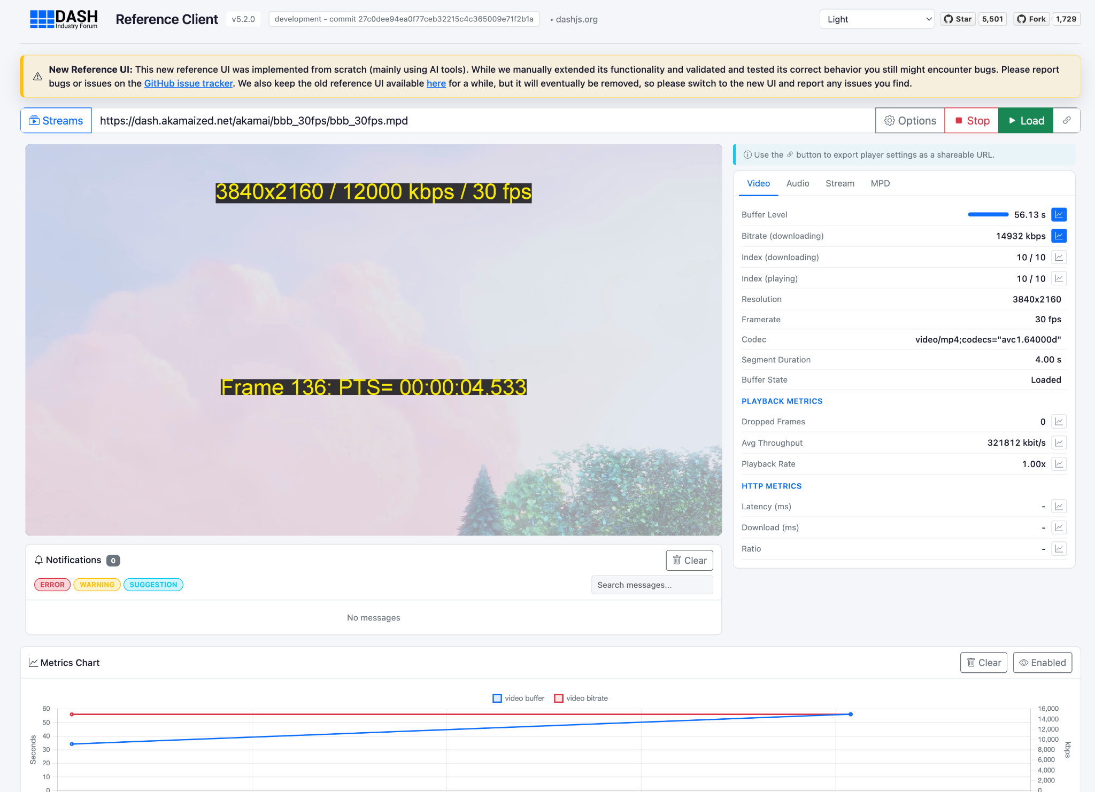
Description
dash.js WG
Description: dash.js is the official reference player by the SVTA DASH-IF WG for playback of MPEG-DASH content
Application Areas: Used by SDOs as reference client, by the industry as foundation for commercial grade players and by the research community as baseline for research purposes
Output: Open-source project on GitHub, last released version 5.1.1
Synergies: DASH-IF WG, Players & Playback WG, Measurement/QoE WG, Low Latency Streaming WG
More Information: https://github.com/Dash-Industry-Forum/dash.js/
Documentation: https://dashif.org/dash.js/
Main Contact: Daniel Silhavy (Fraunhofer FOKUS)
https://reference.dashif.org/dash.js/nightly/samples/dash-if-reference-player/index.html

Slide 3
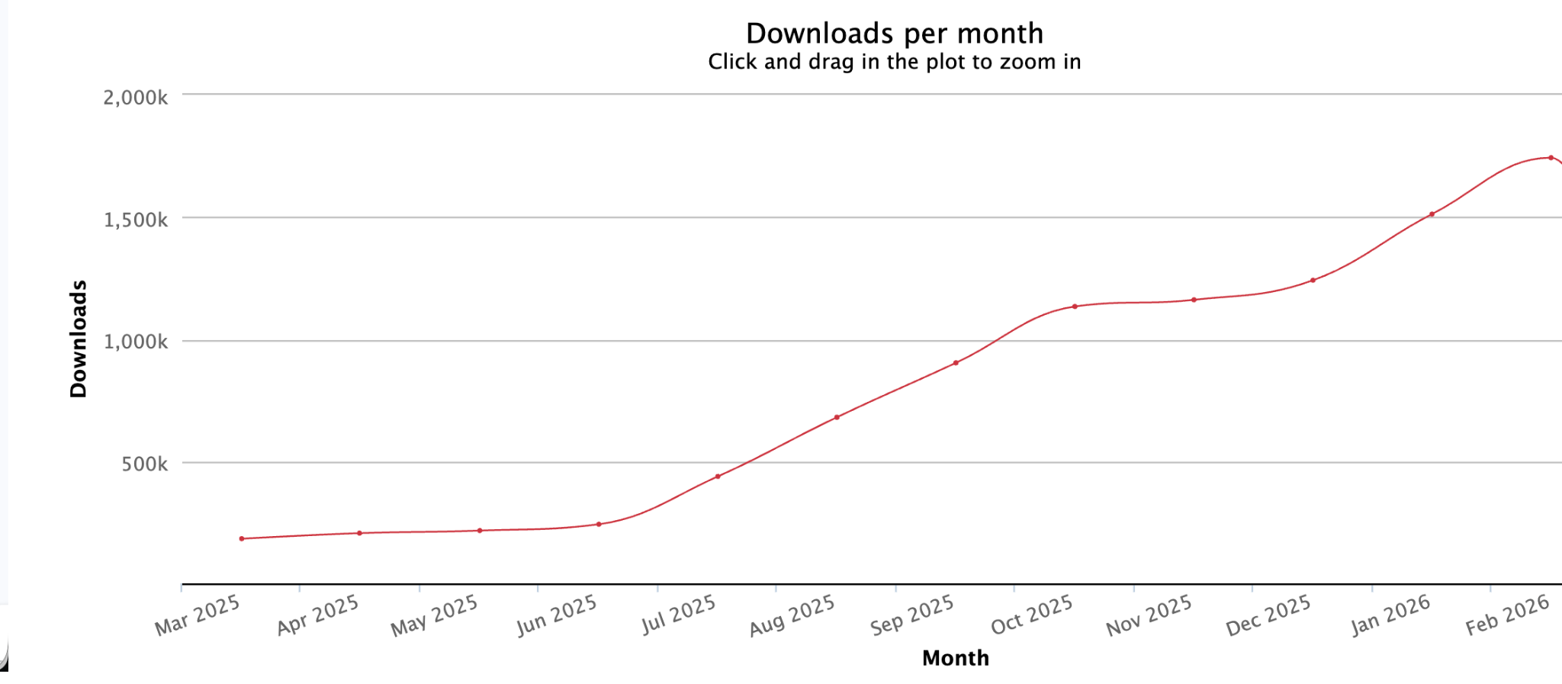
Numbers - GitHub + NPM
dash.js WG
GitHub Numbers
Over 1.7k forks
Over 5.5k stars
Dependents: Over 7600 GitHub projects
61 releases
200 contributors
NPM downloads per month
v5.1.0 rel.
v5.0.0 rel.
1.742.928 downloads in Feb 2026

Slide 4
Latest (main) changes in v5.1.0
dash.js WG
L3D DASH: Initial support for SSR, partial segments and Segment Sequence Properties
LCEVC support: Adds MPEG-5 LCEVC scalable support into dash.js to enable playback of ABR profiles generated by LCEVC enhancement via a separate adaptation set
External Subtitle Files: Adds an API to specify external subtitles that are then added to the internal manifest representation of dash.js right after parsing
CML XML Parser: Replace tXml with CML's parseXml function
DRM Key Session Handling: Configure maximum number of open key sessions
Cue Interval Tree: Prevents browser from hanging during certain operations, when handling very large VTT files
Support for Preselection Elements: Support for parsing Preselection elements into MediaInfo
Documentation Updates: https://dashif.org/dash.js/
Various Bugfixes and Improvements
  Milestone: https://github.com/Dash-Industry-Forum/dash.js/milestone/59
  Project Board: https://github.com/orgs/Dash-Industry-Forum/projects/12
Notes:
CML
MPD patching
Annex I
Flexible Insertion of URL parameters
Instruct the player to use query parameters from the MPD request and append them to segment requests or steering requests
Signaled inside EssentialProperty element
Parameters may be instantiated from designated HTTP headers (from HTTP response)
Forced Subtitle
If no subtitle track selected we choose the forced subtitle track according to the selected language
Expect forced subtitles to be present in regular subtitle track
CAT
Adding an access token to outgoing requests
Extract token from response header

Slide 5
Latest and planned (main) changes for v5.2.0
dash.js WG
Added
Ongoing
Support for Certurl element
DASH + Fairplay DRM Support
  Contribution by Eyevinn
Low Latency improvements including a step based catchup mechanism
  Contribution by BBC
New reference UI
  https://reference.dashif.org/dash.js/nightly/samples/dash-if-reference-player/index.html
Various minor improvements to reduce memory consumption
  Contribution by ARTE
Cleanup GitHub actions
CMCD v2 support
  Pending PR by Qualabs: https://github.com/Dash-Industry-Forum/dash.js/pull/4816
Alternative Media Presentations
  Pending PR by Qualabs: https://github.com/Dash-Industry-Forum/dash.js/pull/4868
Rework sample section
Optimize build process
Migrate test suite
Notes:
CML
MPD patching
Annex I
Flexible Insertion of URL parameters
Instruct the player to use query parameters from the MPD request and append them to segment requests or steering requests
Signaled inside EssentialProperty element
Parameters may be instantiated from designated HTTP headers (from HTTP response)
Forced Subtitle
If no subtitle track selected we choose the forced subtitle track according to the selected language
Expect forced subtitles to be present in regular subtitle track
CAT
Adding an access token to outgoing requests
Extract token from response header

Slide 6
Other topics
dash.js WG
Segment@Pattern: Segment or Segment Sequence durations form a regular pattern
L3D DASH: Additional improvements to enable quality switches on partial segment boundaries
Content Steering v1.0.0: Update the Content Steering implementation to be compliant with v1.0.0 of the ETSI specification
C2PA: Box parsing and dispatching of UUID information
Common Player Error Codes: Common Error Player Error Codes as defined in the SVTA QoE WG
Notes:
Media presentation insertion
insertion of an alternative Media Presentation into the current (main) Media Presentation at a certain point of the Media Presentation timeline
After the playback of the alternative Media Presentation, the playback is continued with the main Media Presentation.
Example: Preroll, Midroll
Signaled using an Alternative MPD event
L3D DASH
Segment sequence representations
Lower GOP size
Fast startup
Low latency quality switches – Fetch individual partial segments
Segment@Pattern signaling: Signal patterns in the timeline that occur multiple times

Slide 7
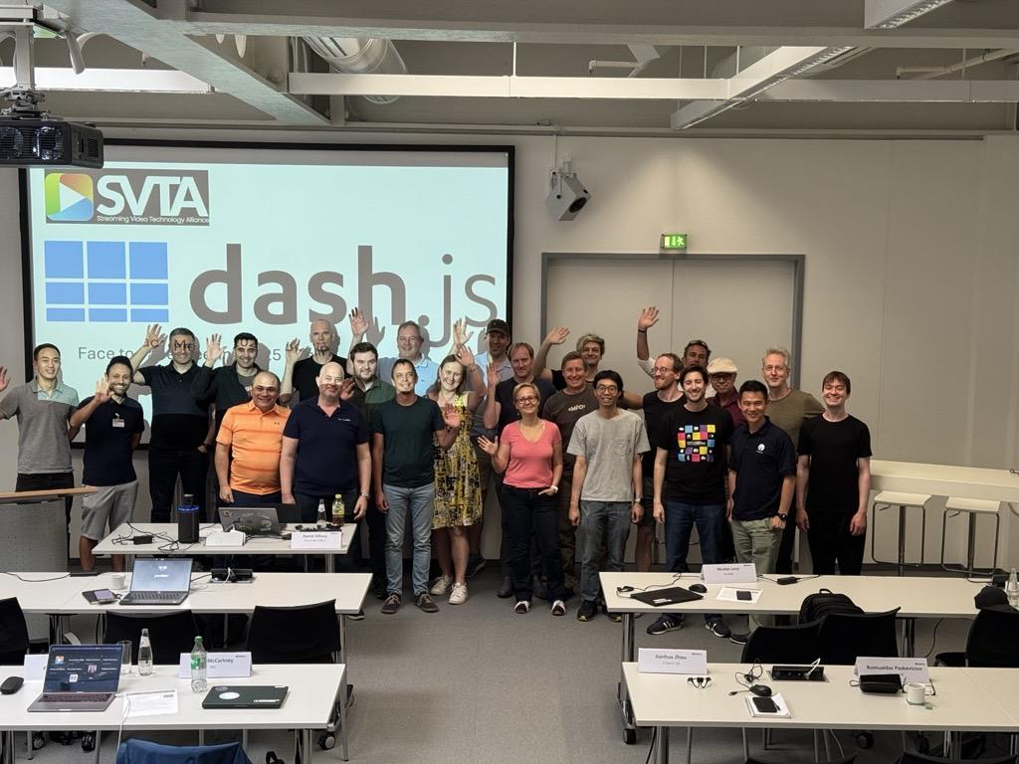
How to participate?
dash.js WG
Github: https://github.com/Dash-Industry-Forum/dash.js
Slack: https://dashif-slack.azurewebsites.net
Reference Client: https://reference.dashif.org/dash.js/nightly/samples/dash-if-reference-player/index.html
Next F2F on June 15th co-located with MWS. More information: https://mws.fraunhofer.de/

