Slide 1
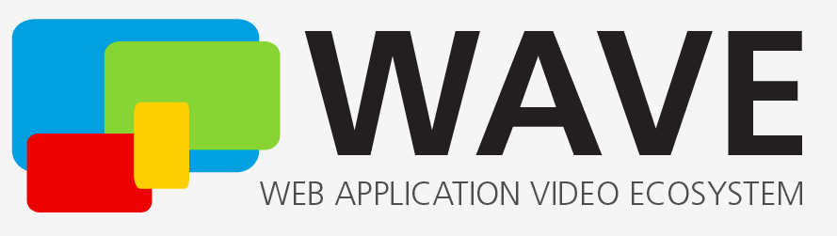
CMAF Test Vectors and
Content Options
For MPEG#143
July 11, 2023
Thomas Stockhammer (Interim DPCTF Chair)

Slide 2
Overview
Background
Content Options
  What exists in DPC Spec?
  How are they used in DPC Test Suite?
  What is missing in DPC Spec?
  Proposal for Content Options in 2023 Content Specification
Test Vectors
  What exists
  How are they used in DPC Test Suite
  Process to approved standalone Test Vectors

Slide 3
Background

Slide 4
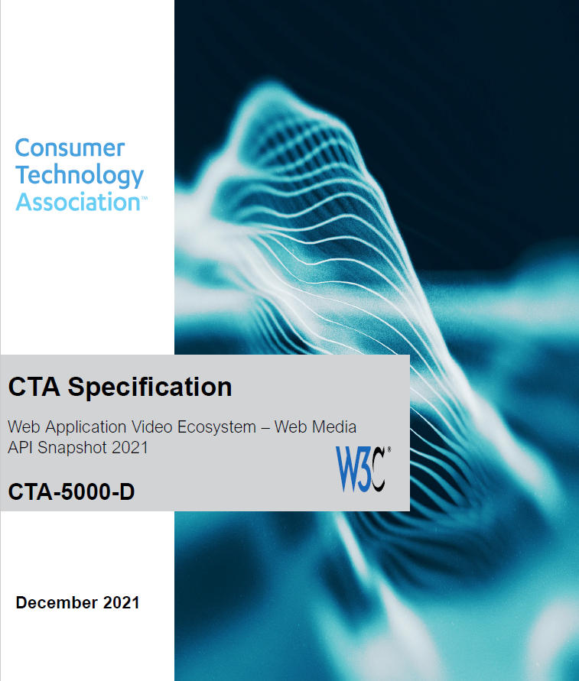
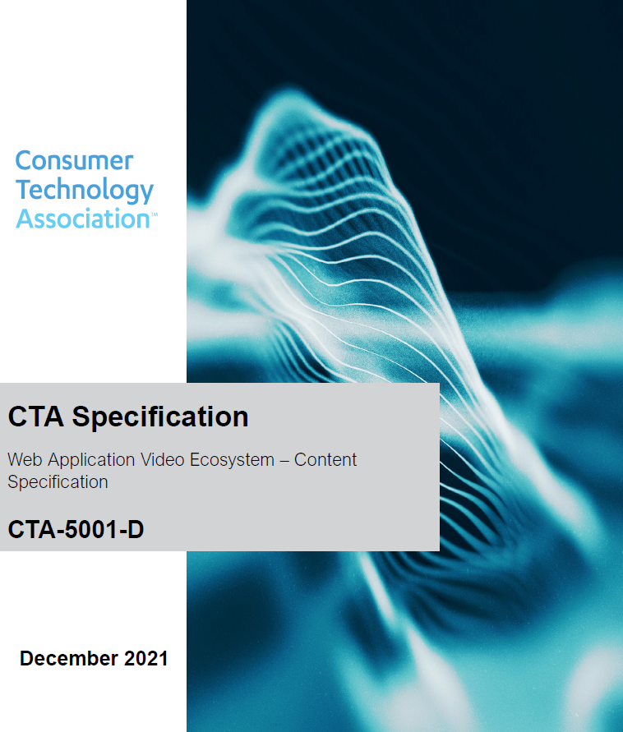
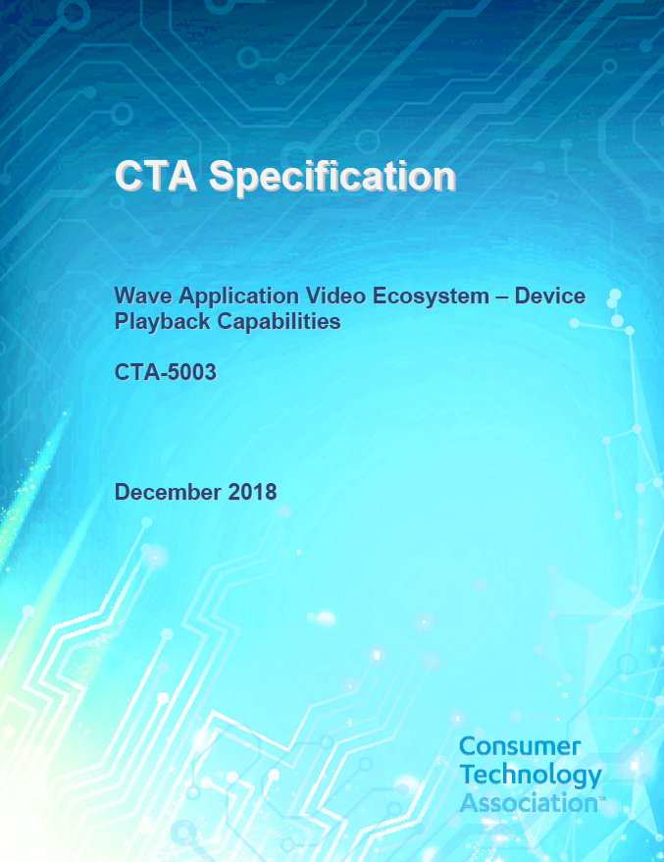
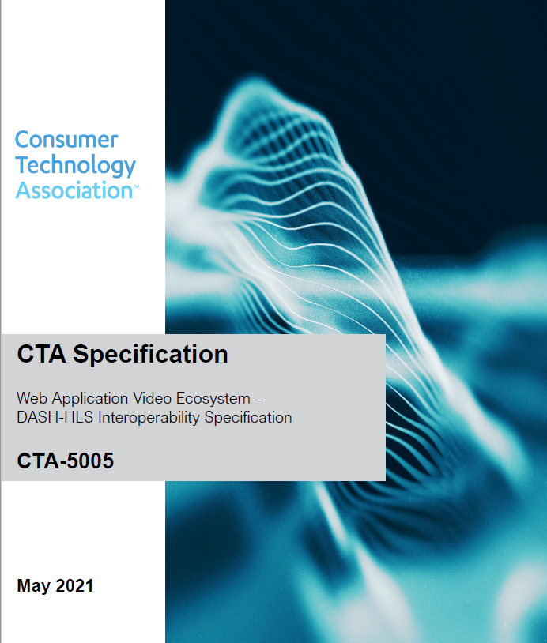
Selected CTA WAVE Specifications
https://www.cta.tech/Resources/Standards/WAVE-Project#specs

Slide 5
WAVE Specification Context

Slide 6
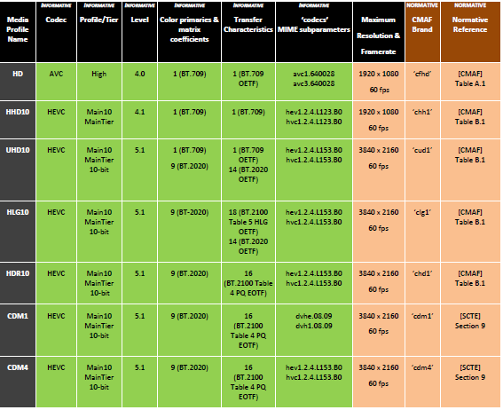
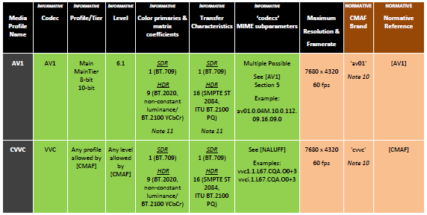
Content Specification for Video – CMAF!
Added in December 2021

Slide 7
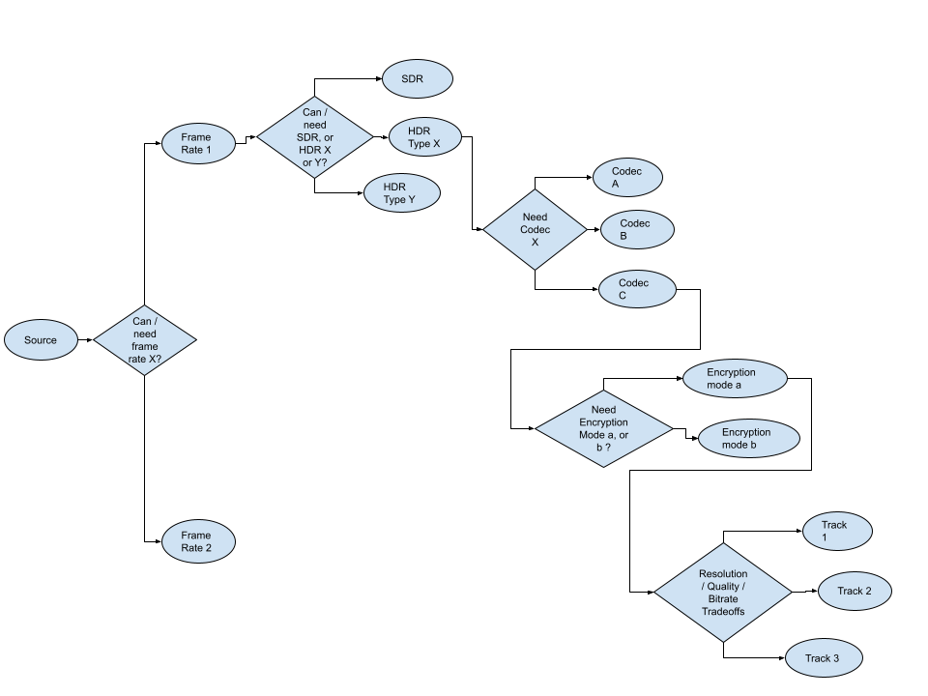
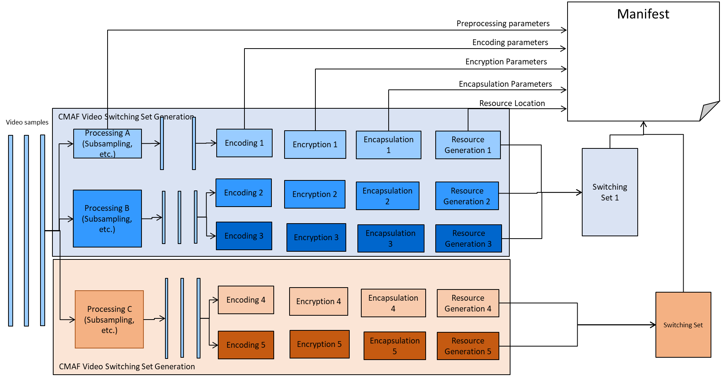
Content offering and Selection
Manifest
Application
(e.g. Media Player like dash.js)
CMAF Header
Notes:
Thomas

Slide 8
Abstracted Device Playback Model
Stimulus/Input
Device Capabilities
Observations
Audio Source Buffer
Device Playback Model
Audio Source Buffer
Visual Rendering
Video Source Buffer
Video Source Buffer
Audio Rendering
Subtitle Source Buffer
Requirements: If you input WAVE content, this shall be the observation

Slide 9
Device Playback Focus
Device definition:
  Codecs & Rendering, possibly on different devices (HDMI, Miracast, etc.)
Capabilities discovery
Playback of a Presentation (of Media Profiles)
  Player Requirements such as splicing segments, switching, random access
Playback of a sequence of Presentations
  Splicing—for example for ad insertion or program boundaries
Other playback capabilities, e.g. support for multiple decoders

Slide 10
Device Playback Focus
For an application to make use of the device platform for playback of a CTA WAVE content, it requires the following principal actions:
  Establishing a Media Element that enables the control and presentation of media data.
  Establishing a Media Source that serves as the source of media data for a Media element.
  Checking if the device is capable of establishing a Source Buffer for playback of a specific CMAF media profile.
  Establishing a Source Buffer that enables the playback of the WAVE through a well-defined set of APIs.
  Using the source buffers and the media element for controlled playback.
A device establishes a Source Buffer for a media type only if the device is capable of playing back at least one of the included WAVE media profiles for each media type in the WAVE content offerings.
Once a source buffer for a media type is established, this source buffer is used for the playback of the media type.

Slide 11
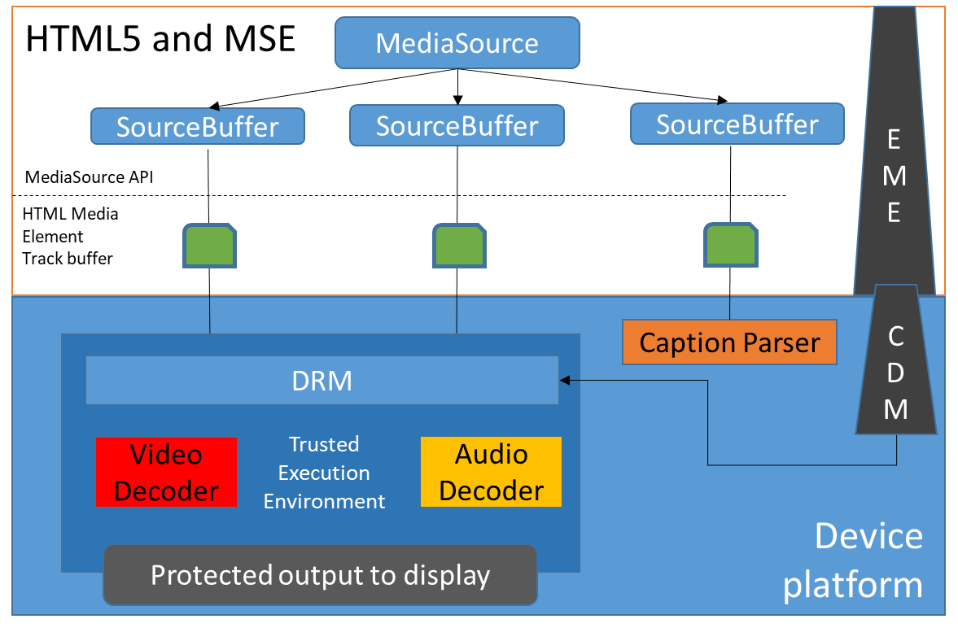
Connection to HTML5 & MSE
HTML5 and MSE
Provide APIs for applications to playback WAVE content
Extend APIs to ensure more consistent and richer user experience
Device Playback Platform:
Ensuring that WAVE content can be “played” consistently when using “MSE-like” APIs for different use cases and applications.
Use HTML5 as reference and test platform, not excluding other platforms

Slide 12
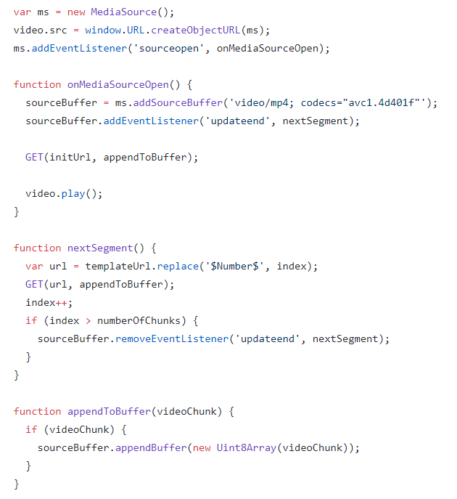
Device Playback
One of the key missing pieces for consistent Internet TV Services
Media Source Extension
  Extends HTMLMediaElement
  Enables JavaScript to generate media streams for playback.
  Allowing JavaScript to generate streams facilitates a variety of use cases like adaptive streaming and time shifting live streams.
ByteStream Format for ISO BMFF
  https://www.w3.org/TR/mse-byte-stream-format-isobmff/
  This specification defines a Media Source Extensions™ [MEDIA-SOURCE] byte stream format specification based on the ISO Base Media File Format.

Slide 13
Spec Highlights and Outline Jul 2023
Architecture and Device Reference Model
Media Playback Model
DRM Protected Media
Single-Track Media Playback Requirements
WAVE Content Playback Requirements
General CMAF Requirements and Tests
Video Media Profiles
Audio Media Profiles
Subtitle Media Profiles
Other Playback Requirements
Device Core Profiles
Device Extension Profiles
Configurations
Annex A Device Capability Discovery
Annex B Relevant HTML-5 APIs
Annex C Test Content Format Specification
Sequential Track Playback
Random Access to Fragment/Time
Switching Set Playback
Playback of Chunked Content
Playback over WAVE Baseline Splice Constraints
Out-Of-Order Loading
Overlapping Fragments
Full Screen Playback of Switching Sets
Playback of Encrypted Content
Source Buffer Re-Initialization
Buffer Underrun and recovery
Low Latency Playback
Regular Playback of a CMAF Presentation
Random Access of a CMAF Presentation
Splicing of WAVE Program with Baseline Constraints

Slide 14
Example: Switching Set Playback
Playback of a switching set assumes that the application can switch across the fragments of different tracks without observing any temporal or spatial misalignment during playback.
Stimulus
  For a track buffer that supports a media profile, playback of a Switching Set of a CMAF Switching Set, consisting of K tracks, the following applies:
  Set the LastHeader to the CMAF Master Header CH* used in initialization
  Set presentation time offset to tf[k=playout[i=1],i=1].
  Load as many CMAF fragments CF[k,i] starting from fragment 1 such that the buffer duration is at least min_buffer_duration using the Append-Algorithm-1, outlined below.
  Once reached the min_buffer_duration, initiate play-back on the media source and observe:
    The measured time when playback is initiated is Ti.
    The measured time when the first sample is rendered at time TR[s=1].
    The measured time when sample s is rendered is time TR[s].
  While it is not the last fragment, do:
    As soon as the buffer is equal to min_buffer_duration or below, append next fragment CF[k,i] using Append-Algorithm-1, outlined below.
  Stop at the end of the last CMAF Fragment in the buffer.
  Append-Algorithm-1:
  For each CMAF Fragment position i=1,…,N.
    If CMAF Header CH[k = playout[i]]!= LastHeader.
      Append the CMAF Header CH[k=playout[i]] to the Source Buffer
      Set LastHeader to CH[k=playout[i]].
    Append CMAF Fragment CF[k=playout[i],i].
Required Observation
  Every sample S[k,s] shall be rendered and the samples shall be rendered in increasing presentation time order.
  The duration of the playback matches the duration of the CMAF Track, i.e., TR[k, S] = TR [k, 1] + td[k].
  The start-up delay should be sufficiently low, i.e., TR[k, 1] – Ti < TSMax
  The presented sample matches the one reported by the currentTime value within the tolerance of the sample duration.

Slide 15
Media Profile Template for Device Playback (Example UHD10)
Definition:
  CMAF HEVC UHD10 is defined in [WAVE-CON], clause 4.2 and [CMAF]
Capability Discovery Options
  <brand>,<codecs>,<max-bitrate>,<max-framerate>, Color and Transfer characteristic
Source Buffer Initialization
  codecs parameters video/mp4 codec="hev1.2.4.L153.B0"
Content Options
  CMAF options: inband parameters sets, sample entry presences, etc.
  Content options: frame rates, resolutions, aspect ratio, color transfer, etc.
  Encoding and Packaging: SEI, Sample entry, Fragment duration, etc,
Test Content (see next slide)
Playback Requirements
Test Cases

Slide 16
Example Test Content UHD10
Number | Default flags | Sample entry | chunks | Spatial and temporal supsampling | Source content
hevc21 | yes | hvc1 | 1 | no | 3840x2160p50
hevc22 | no | hev1 | 1 | no | 3840x2160p50
hevc23 | yes | hvc1 | 10 | no | 3840x2160p50
hevc24 | yes | hvc1 | 1 | 3 spatial (2160, 1440, 1080) 2 temporal (50 & 25) | 3840x2160p50
hevc25 | yes | hvc1 | 1 | 3 spatial (2160, 1440, 1080) 2 temporal (30 & 60) | 3840x2160p @ 60/1.001

Slide 17









Dynamic Tests – Status
Test Execution Framework
CTA Original
Content Pool
Test Runner
instructions
Test
Runner
Device
Content Annotation
Control API
Test Content Usage Instructions
Media API
CTA Mezzanine
Content Pool
"Playlist"
No
Observations
CTA
Content
Verifier
Yes
MPD +
CTA WAVE Test Content
Media Profile
Encoding

Slide 18
Contributors
Description | Main contributor | Link
Test runner | Fraunhofer | https://github.com/cta-wave/dpctf-test-runner
Individual tests | Fraunhofer | https://github.com/cta-wave/dpctf-tests
Deploy | Fraunhofer | https://github.com/cta-wave/dpctf-deploy
DPC Landing Page | Fraunhofer | https://cta-wave.github.io/dpc-test-suite/
Generating test content from mezzanine content | GPAC Licensing for Qualcomm | https://github.com/cta-wave/Test-Content-Generation
Uploading / managing test content | GPAC Licensing for Qualcomm | https://github.com/cta-wave/Test-Content
Generating mezzanine content | TP Vision | https://github.com/cta-wave/mezzanine

Slide 19
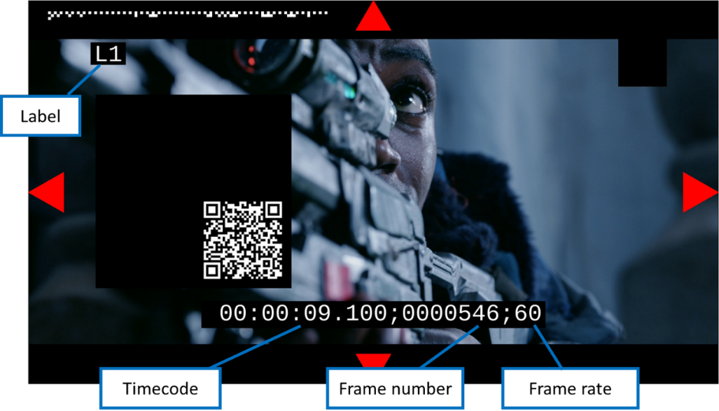
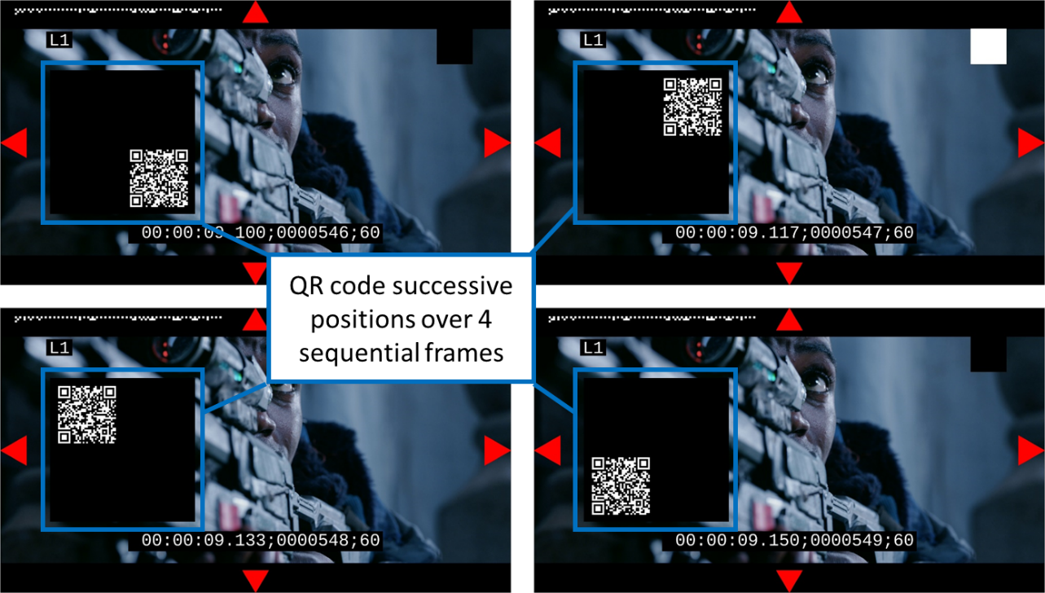
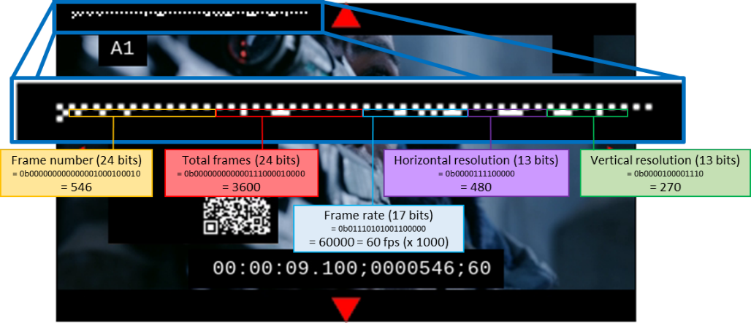
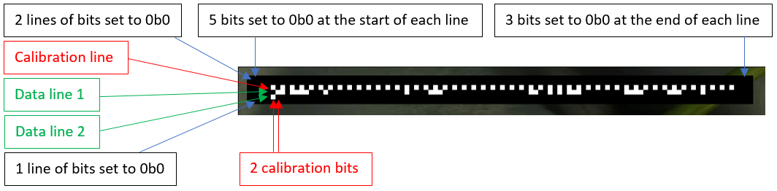
Mezzanine Content

Slide 20
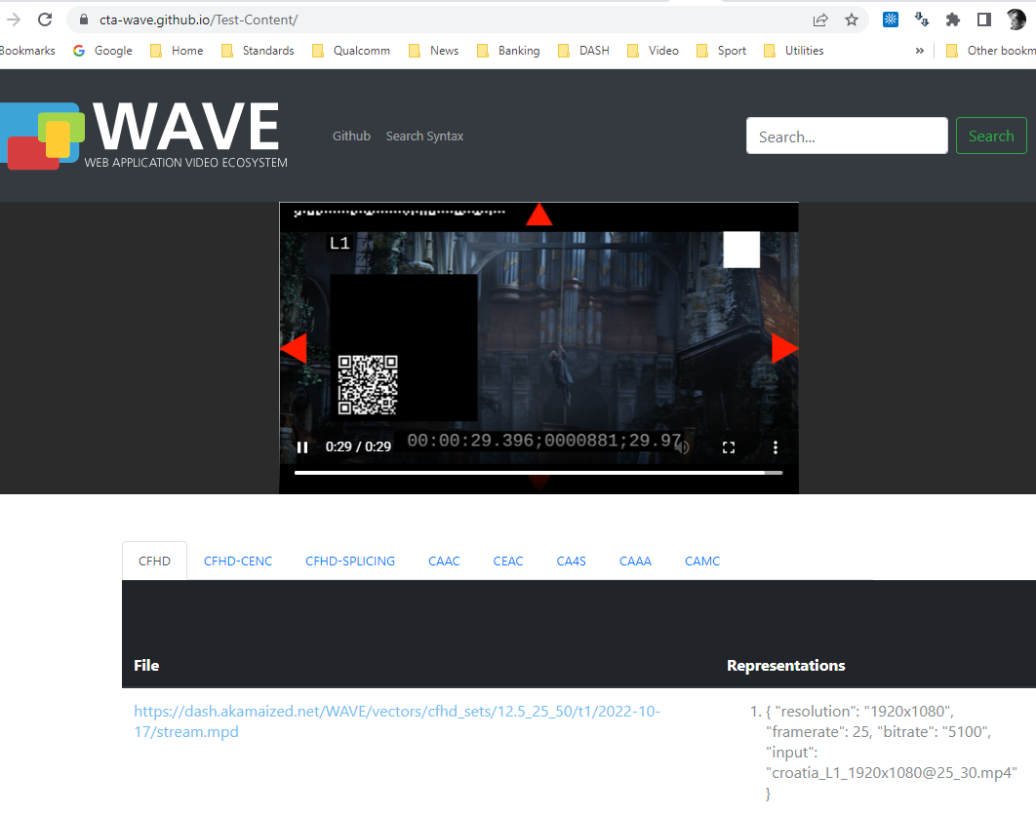
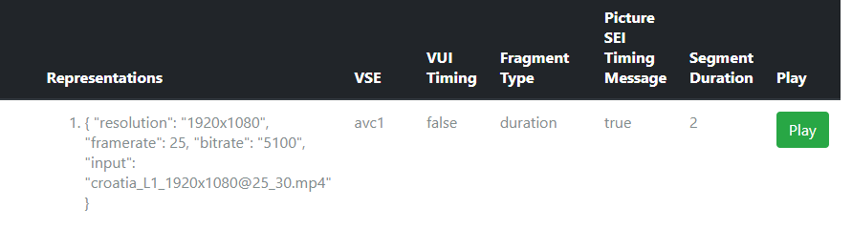
Current Test Content

Slide 21
Content Options

Slide 22
Content Options in DPC Spec (1)
General CMAF (clause 10.2.3, also clause 7 of CMAF [CMAF])
  Compositions offsets and Timing, Inband Parameter Sets, Encryption
Video
  Source Content Options (10.2.2): Resolution, frame rate, subsampling, colour space, transfer characteristics, etc.
  Encoding and Packaging options (10.2.3): SEI/VUI, Sample entry, fragment duration, spatial/temporal subsampling, etc.
Audio
  Source Content Options (10.3.2): channels, sampling frequency, ...
  Encoding and packaging options: per codec, fragment duration

Slide 23
Test Content Matrix

Slide 24
How is this content used?
The content is used to define test cases together with playback instructions
Example
Test Code / Audio Content ID | at1 | at2 | at3 | at4 | at5 | at6 | at7 | at8 | at9 | at10 | at11 | at12 | at13 | at14
8.2 Sequential Track Playback | X |  | X | X |  | X | X | X | X | X | X | X
8.3 Random Access to Fragment | X
8.4 Random Access to Time | X
8.6 Regular Playback of Chunked Content |  | X
8.7 Regular Playback of Chunked Content, non-aligned append |  | X
8.8 Playback over WAVE Baseline Splice Constraints |  |  |  |  |  |  |  |  |  |  |  |  | X | X
8.9 Out-Of-Order Loading | X
8.10 Overlapping Fragments | X
8.12 Playback of Encrypted Content |  |  |  |  | X

Slide 25
What exists and is missing
Existing
Test Content Formats
Source Content options
General CMAF Options
Mezzanine content
Test Content for AVC
Test Content for Audio (AAC, EAC-3, AC-4, DTS)
Missing
Codecs and Media Profiles
  HEVC with different profiles
  Dynamic Mapping
  VVC and AV1
  MPEG-H Audio and USAC
Source and Mezzanine for dynamic mapping content

Slide 26
CMAF Test Vectors
Towards conformance streams

Slide 27
Background
As a byproduct to the Device Playback Test Suite, a set of CTA WAVE test vectors have been developed, that are part of the DPCTF test suite.
Discussion
  Do we release those independently of the Test suite?
  Do we make those CTA WAVE Conformance Bitstreams?
  Do we make those CMAF Conformance bitstreams
  In the future, how can additional test bitstreams be added

Slide 28
Current Test Content
https://cta-wave.github.io/Test-Content/

Slide 29
Content Generation Workflow At A Glance
Original
Content Pool
No
Annotate
Content
Media Profile Encoding
Content Valid?
WAVE Test Content + MPD
Validate
DASH Conformance
Yes
Mezzanine
Content
Test Content
Mezzanine
Content Pool

Slide 30
Test Content Generation https://github.com/cta-wave/test-content-generation
A module exists to automatically generates WAVE test content based on Mezzanine content.
The run-all.py script gathers data and content to process for encoding and packaging. The encode_dash.py script is focused on generating CMAF content with DASH annotations.
Workflow to Create Annotated Content:
Download mezzanine content.
Encode mezzanine content:
  Encode to conform to CTA Proposed Test content.
  Encode at least one option of source content according to media profile.
Package (markup) the content with an MPD according to the CTA Content Model format.
Encrypt the content in-place using GPAC encryption and manifest-forwarding capabilities.
Upload the proposed test content to the CTA-WAVE server using SFTP.
Update database.json
Validate content => see next slides
If validation fails, return to step#2

Slide 31
Test Content Format
Execute among others
  Content Options
  Bitrates
  Resolutions
Annotation
  Use test MPD format as defined in DPC Specification

Slide 32
Content Validation
Use a content validator (for AVC written by Nicholas)
  Run against https://conformance.dashif.org/
    Test that MPD fulfills the test content requirements
    Test CMAF conformance on packaging
  Validate media profile specific requirements
  Add test report to test vector
Checks if it can be played back using dash.js
  Note: HLS M3U and hls playback may be added
Test the usage of the content in the DPC test suite

Slide 33
Backup

Slide 34
Device Playback Compatibility Test Suite: Primer
Introduction and Overview
Javier Arellano
Senior Staff Systems Engineer
Corporate Technical Standards
Original: 4 April 2022
New Version: 7 June 2023

Slide 35
Overview

Slide 36
Module Overview
  This module implements scripts that will generate annotated test content based of raw source content that is compatible with the DPC test suite
  This module builds test content generated from the Mezzanine Content using different codecs and varying media profiles.
  The DPC Test Runner implements an execution environment for tests following the WAVE DPCTF Test Specification. Test Runner uses generated CTA test content and curated test cases.
Mezzanine Content
CTA Test Content
Test Runner
Observation Framework
The DPC Device Observation Framework determines compliance with WAVE DPCTF specification, based on observations including video recording of tests which are run on a device by the Test Runner

Slide 37

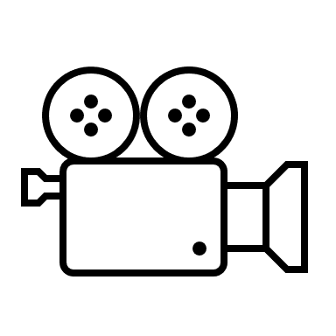
Test Suite Overview
Content Generation Framework
Test Execution Framework
Mezzazine
Content
Test
Content
Test
Runner
Observation Framework
Original
Content Pool
Mezzanine
Content Pool
WAVE Test Content + MPD
Video Recording
(Observations)
TV
Video Camera

Slide 38
Content Generation

Slide 39
Content Generation Workflow At A Glance
Original
Content Pool
No
Annotate
Content
Media Profile Encoding
Content Valid?
WAVE Test Content + MPD
Validate
DASH Conformance
Yes
Mezzanine Content
Test Content
Mezzanine
Content Pool

Slide 40
"<template-id>","<video-test-vector-url>","<audio-test-vector>","<group>"
Mezzanine Content Generation
This module automatically generates WAVE mezzanine content based on raw source content.
The annotations in the resulting multimedia files are used by the WAVE test suite to programmatically identify content parameters and to verify various elements of performance.
Workflow to Create Annotated Content (mezzanine.py)
Adds timecode, frame number with configurable zero padding, frame rate, configurable label text and font encoded in QR code displayed in each frame.
Adds a low-density bit pattern for each frame that signals (frame number, total frames, frame rate, horizontal resolution, vertical resolution)
Adds border indications
Integrates an A/V sync pattern at the top right of the video
Mixes source content audio with A/V sync beeps to allow for visual lip-sync confirmation.
Includes option to add a dark green color frame to indicate the start of the video, and a dark red frame to indicate the end of the video.
Optionally applies rudimentary tone-mapping to BT.709 SDR for each input file, to create SDR mezzanine streams using an HDR source.
Generates JSON metadata related to the mezzanine content, encoding, output file and source file. This includes the mezzanine release version, and the corresponding WAVE Test Content Format Specification version.
Video output configured to minimise lossy nature of transcoding and preserve properties of source content. The codec used depends on source content color space

Slide 41
"<template-id>","<video-test-vector-url>","<audio-test-vector>","<group>"
CTA Test Content Generation
This module automatically generates WAVE test content based on Mezzanine content.
The run-all.py script gathers data and content to process for encoding and packaging. The encode_dash.py script is focused on generating CMAF content with DASH annotations.
Workflow to Create Annotated Content:
Download mezzanine content.
Encode mezzanine content:
  Encode to conform to CTA Proposed Test content.
  Encode at least one option of source content according to media profile.
  Package (markup) the content with an MPD according to the CTA Content Model format.
  Encrypt the content in-place using GPAC encryption and manifest-forwarding capabilities.
  Upload the proposed test content to the CTA-WAVE server using SFTP.
  Update database.json
  Validate against MPD and CMAF conformance for CTA WAVE test content (https://conformance.dashif.org/)
  If validation fails, return to step#2

Slide 42
Test Generation

Slide 43

Test Generation Architecture
WAVE
Test Content + MPD
Content Pool
HTML Template
HTML Template
HTML Template
Use Cases
CSV file*
* [<template ID>, <video test vector>, <audio test vector>],….
Tests
(.json)
Auto-Generate
configuration from Selected streams
Instantiate
Selected
Templates
Generate Files
No
Yes
generate-tests.py
HTML Template
HTML Template
HTML
Configuration
Global-Level
Configuration
(.json)
Template-Level
Configuration
(.json)
Test Specific-Level
Configuration (.json)

Slide 44
"<template-id>","<video-test-vector-url>","<audio-test-vector>","<group>"
Test Generation Workflow
Create/Modify CSV file where each row entry represents a generated test:
  "<template-id>","<video-test-vector-url>","<audio-test-vector>","<group>“
    template-id: What template to use.
    video-test-vector-url: URL to the video test content.
    audio-test-vector-url: URL to the audio test content.
    group: Name to group the generated test by. A directory per group is created.
Apply test configuration (test-config.json) where test parameters can be scoped at a global-level, a template-level, or a test-level where each level overrides the preceding level.
Auto-generate test configuration from the selected streams referenced in the testcases (CSV entries).
Generate test configuration file (tests.json) and tests (.html).

Slide 45
"<template-id>","<video-test-vector-url>","<audio-test-vector>","<group>"
Example Test (1)
Test Case (Entry in tests.csv)
Corresponding Test (tests.json)
    "tests": {
    "6cef9b95c8053107d0b867da124d42b7": {
    "path": "avc_15_30_60-online/sequential-track-playback__t1.html",
    "video": [
    "https://dash.akamaized.net/WAVE/vectors/avc_sets/15_30_60/t1/2022-01-17/stream.mpd"
    ],
    "audio": [],
    "code": "sequential-track-playback.html",
    "switchingSets": {
    "video": [
    {
    "cmaf_track_duration": "PT0H1M0.000S",
    "fragment_duration": "PT0H0M2.016S",
    "representations": {
    "2": {
    "period": 1,
    "duration": 60,
    "type": "video",
    "frame_rate": "30",
    "fragment_duration": 2.0
    }
    }
    }
    ],
    "audio": []
    }
    },
sequential-track-playback | https://dash.akamaized.net/WAVE/vectors/avc_sets/15_30_60/t1/2022-01-17/stream.mpd | avc_15_30_60-online

Slide 46
"<template-id>","<video-test-vector-url>","<audio-test-vector>","<group>"
Example Test (2)
HTML Template (excerpt of sequential-track-playback.html)
<script>
// Global variables
var TEST_INFO = {
id: "sequential-track-playback",
title: "Sequential Track Playback",
description:
"Sequential track playback refers to the case that a CMAF/WAVE track is played from the beginning by providing CMAF fragments to the source buffer after initialization.",
path: "{{TEST_PATH}}",
code: "{{TEMPLATE_NAME}}"
};
var video = document.querySelector("video");
var qrCode = document.getElementById("qr-code");
var statusText = document.getElementById("status-text");
var videoContentModel = "{{VIDEO_MPD_URL}}";
var audioContentModel = "{{AUDIO_MPD_URL}}";
var dpctfTest = new DpctfTest({
testInfo: TEST_INFO,
videoContentModel: videoContentModel,
audioContentModel: audioContentModel,
videoElement: video,
qrCodeElement: qrCode,
statusTextElement: statusText,
infoOverlayElement: document.getElementById("info-overlay"),
executeTest: executeTest,
usePlayout: false,
});
function executeTest(player, done, parameters) {
var minBufferDuration = parameters.minBufferDuration / 1000;
player.startBuffering();
dpctfTest.asyncTest(function (test) {
var query = location.search.replace(/\?/, "");
var match = query.match(/redirect_time=([^&]+)/);
var REDIRECT_TIME = match ? match[1] : null;
if (!REDIRECT_TIME) REDIRECT_TIME = 5;
video.addEventListener("ended", function (event) {
assert_true(true);
test.done();
});
}, "video ended event fired");
if (player.getPreBufferedTime() >= minBufferDuration ||
player.getPreBufferedTime() >= player.getDuration()) {
player
.play()
.then(function () {
done();
})
.catch(function (error) {
done(error);
});
} else {
var loadedEvent = "onVideoSegmentLoaded";
if (videoContentModel.length === 0) loadedEvent = "onAudioSegmentLoaded";
player.on(loadedEvent, function (event) {
if (player.getPreBufferedTime() >= minBufferDuration ||
player.getPreBufferedTime() >= player.getDuration()) {
player
.play()
.then(function () {
done();
})
.catch(function (error) {
done(error);
});
}
});
}
}
</script>

Slide 47
Execution Environment

Slide 48
Components
  The DPC Test Runner is implemented in a Docker image.
  Test Runner is based on W3C’s web-platform-tests framework.
  The framework is a cross-browser test suite for the Web-platform stack
  The Observation Framework (OF) is an application to process and analyze video recordings of tests executed by the Test Runner.
  OF utilizes opencv-python, an open-source image processing framework and Zbar, a bar code reader library.
  OF requires Test Runner to be co-located on same host computer and visible to OF.
Test Runner
Observation Framework

Slide 49

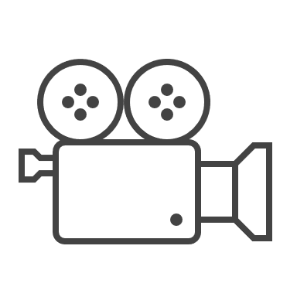
Deployment Options (1)
Option A
  Execute the test on the same machine as the DPCTF test runner is executing on.
  Docker Container and Observation Framework on same host
  Record user agent/browser
Test
Runner
Companion
Webpage
Landing
Webpage
Video Recording
Docker
Observation Framework
Host Machine
Option A: Single Device
Option B
  Execute the test on the same machine as the DPCTF test runner is executing on.
  Docker Container and Observation Framework on same host
  Record user agent/browser
Test
Runner
Companion
Webpage
TV
TV
Landing
Webpage
Docker
Video Recording
Observation Framework
Host Machine
Option B – Device Under Test (DUT)

Slide 50
Deployment Options (2)
Companion Device Deployment
Option C
  Companion device configures and manages the test.
  Docker Container and Observation Framework on same host
  Record user agent/browser
Test
Runner
TV
TV
TV
Landing
Webpage
Landing
Webpage
Docker
Observation Framework
Video Recording
Host Machine
Configuration
Webpage
Companion Device
Option C – Companion Device

