Slide 1

Standards for Global OTT Video: The WAVE Project
Mike Bergman
Sr. Director, Technology & Standards
Consumer Technology Association
William Law
Vice-Chair, CTA WAVE Project Steering Committee
Chair, WAVE Technical Working Group
Chief Architect, Media, Akamai

Slide 2


Commercial OTT Video Issues: Content Format Issues
Content Format
m3u8
Each “asset” copied to multiple media formats
different video codecs
different audio codecs
Regional frame rates
Cost to content creators and distributors
Inefficiencies in content delivery networks (CDNs)
Storage costs
HLS
mpd
DASH
ismc
Smooth
f4m
HDS

Slide 3

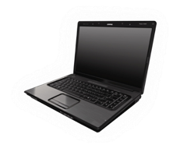
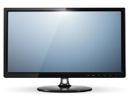


Commercial OTT Video Issues: Device Playback Issues
Content Format
Device Playback
- Switching bitrate glitches
- Codec incompatibility
- Scaling display issues
- Partial profile support
- Long-term playback instability
- Audio discontinuities
- Request protocol deficiencies
- Memory problems
- CPU weakness
- Variable HDR support
- Unknown capabilities
- Ad splicing problems
m3u8
mobile
apps
HLS
mpd
PC
apps
DASH
TV
apps
ismc
Smooth
game
apps
f4m
set-top
apps
HDS

Slide 4

Commercial OTT Video Issues: Reference Platform Issues
Content Format
Device Playback
Reference Platform
m3u8
test
apps
mobile
apps
HLS
mpd
PC
apps
- Distributors need consistent app behavior across platforms
- WAVE testing needs neutral, well-known reference platform
- Each device platform has different video features, APIs and semantics.
DASH
TV
apps
ismc
Smooth
game
apps
f4m
set-top
apps
HDS

Slide 5
WAVE Membership
Adobe Systems
AGP
Akamai
Amazon.com
Apple
AT&T
AwoX
BBC Research & Development
BitRouter
BrightCove
Cable Television Labs
castLabs
Comcast Cable
Consumer Technology Association
Cox Communications
Discovery Communications
Disney/ABC/ESPN
Dolby Laboratories
DTS
Ericsson
Eurofins Digital Testing
Facebook
Fraunhofer
Google
Home Box Office (HBO)
Intel Corporation
JW Player
LG Electronics
Microsoft Corporation
MLBAM
Motion Picture Association of America
Motion Picture Labs
Nagravision
National Association of Broadcasters
Netflix
Opera Software
P Thomsen Consulting
Qualcomm Incorporated
RK Entertainment Technology Consulting
Samsung Electronics
Sharp Electronics Corporation
Sky
Society of Cable Telecommunications Engineers
Solekai Systems
Sony Electronics
SpireSpark International
Starz
Streamroot
TBT
Toshiba
TP Vision Holding B.V.
Ustudio
Verance Corporation
Verimatrix
Verizon
Viacom
Vizio
WJR Consulting
World Wide Web Consortium
WWE
Company names in bold are members of the WAVE Steering Committee.

Slide 6
Commercial OTT Video Issues: WAVE Solution
Content Specification
Device Playback Requirements
HTML5 Reference Platform
Content Specification based upcoming ISO MPEG Common Media Application Format (CMAF), compatible with DASH and HLS.
Testable requirements covering the most common device playback interoperability issues.
Reference application framework based on HTML5 providing functional guidelines for playback interoperability.
Test Suite

Slide 7
WAVE Organization
Steering Committee
Technical Working Group
Addressing
Content Preparation Problems
HTML5 API
Task Force
Device Playback
Capabilities
Task Force
Content Specification
Task Force
Test & Compliance Task Force

Slide 8
3 important facts about WAVE
WAVE is global in scope, not just North American. WAVE welcomes increased global participation.
HTML5 APIs are the basis for the preferred common video application environment, but other environments are supported.
The MPEG Common Media Application Format (CMAF) is the basis for content preparation.

Slide 9
WAVE Organization
Steering Committee
TWG WAVE Technical Working Group
Coordinates between Task Forces
Currently collecting Task Force issues to discuss at a Workshop later this week (4/27)
Technical Working Group
Addressing
Content Preparation Problems
HTML5 API
Task Force
Device Playback
Capabilities
Task Force
Content Specification
Task Force
Test & Compliance Task Force

Slide 10
Content Specification
Task Force

Slide 11
WAVE Organization
Steering Committee
Technical Working Group
CSTF Content Specification Task Force
Developing a Content Specification
  …that cites MPEG-CMAF packaging format
  …and additional (non-MPEG) Media Profiles (codecs)
Following the progress of the MPEG publication of CMAF
Tracking “Issues” on Github
Identifying relevant non-MPEG Media Profiles and seeking proponents
Release targeted for this summer
Addressing
Content Preparation Problems
HTML5 API
Task Force
Device Playback
Capabilities
Task Force
Content Specification
Task Force
Test & Compliance Task Force

Slide 12

The Rise of Global Standards
JavaScript control of adaptive streaming
  HTML5 Media Source Extensions (MSE) – W3C
JavaScript interaction with DRM
  HTML5 Encrypted Media Extensions (EME) – W3C
Manifest format
  HTTP Live Streaming (HLS), MPEG DASH
DRM-Interop encrypt/decrypt
  Common Encryption for fragmented MP4 - ISO MPEG CENC
Manifest independent encoding
  Common Media Application Format – ISO MPEG CMAF
Notes:
CMAF will be just the latest of a number of global standards which have quietly appeared over the last six years.
Microsoft first proposed a DRM-interoperable encoding format in 2009. Common Encryption and Dynamic Adaptive Streaming over HTTP or DASH were finalized in 2011 and published in 2012.
The same year that Microsoft, Google and Netflix proposed commercial media extensions to HTML5 – the encrypted media extensions and media source extensions.
Microsoft believes CMAF will play a central role in bringing these standards together and revolutionize OTT commercial media delivery. And this is why it is so important to WAVE.

Slide 13






CMAF – Multi-platform OTT workflow today
Consumers on different playback devices
m3u8
m3u8
HLS
mpd
mpd
DASH
CDN
delivery
Source content
ismc
ismc
Cloud encoder
m3u8
Smooth
mpd
ismc
f4m
f4m
f4m
Multiple media segments compete for cache space at the edge
HDS

Slide 14
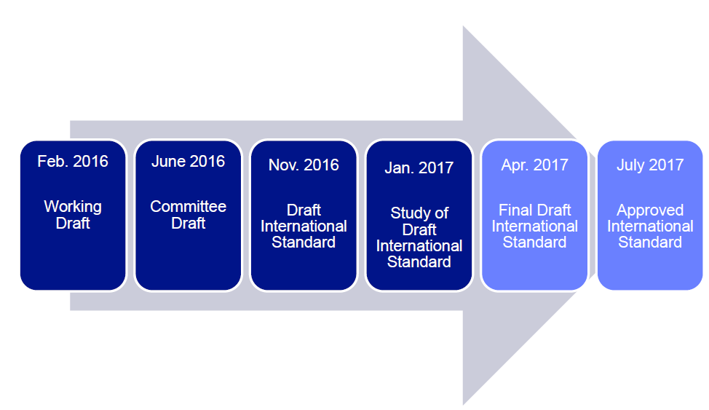
CMAF History and Roadmap
In January 2015, Microsoft and Apple had private closed-door meetings with 8 companies and proposed a new media format which would be common between HLS and DASH.
Held conf calls and meetings to discuss format.
Apr. 2017
Final Draft International Standard
CMAF Development Timeline: a very fast standardization pace
(adapted from C. Concolato)
Proposed at MPEG’s 114th meeting in San Diego in Feb 2016.
Requirement proposal presented: Adobe, Akamai, Apple, BBC, Cisco, Comcast, DTG, Ericsson, Fraunhofer, iStreamPlanet, LG Electronics, Microsoft, MLBAM, Qualcomm, Samsung, Starz, Telecom Italia, Turner, Verimatrix, WWE.
Draft specification presented: Apple, Microsoft, MLBAM, Cisco, Akamai and Comcast.
MPEG approved the establishment of a new standard:
      ISO/IEC 23000-19 - Common Media Application Format

Slide 15
Multi-platform OTT workflow with CMAF
Consumers on different playback devices
m3u8
m3u8
mpd
HLS
m3u8
More efficient edge caching
mpd
mpd
mpd
m3u8
mpd
CMAF
m3u8
DASH
Storage and packaging costs
reduced
CDN
delivery
Source content
mpd
ismc
m3u8
mpd
Cloud encoder
ismc
m3u8
m3u8
Smooth
mpd
ismc
f4m
f4m
Multiple media segments compete for cache space at the edge
mpd
f4m
m3u8
HDS

Slide 16
Common Media Application Format Goals
Requirements - a common encoding format for media delivery
  Adaptive streaming - compatible with HLS and DASH
  Download – for local playback
  Broadcast/multicast over terrestrial and satellite networks
  Hybrid delivery – combining broadcast and broadband delivery.
  Server-side and Client-side ad insertion with media segment and manifest-level signaling of messages for ad insertion and other purposes
Benefits
  Reducing encoding cost by half
  Reduces storage cost by half
  Doubles CDN cache efficiency

Slide 17
Core Technologies
ISOBMFF, fMP4 container, specifically ISO/IEC 14496-12:201
Common Encryption (CENC) - ISO/IEC 23001-7: 2016
            Allows both “cenc” and “cbcs” modes of operation (also cens, cbc1)
Supports the MPEG codec suite of AVC (ISO/IEC 14496-10), AAC (ISO/IEC 14496-3) and HEVC (ISO/IEC 23008-2) codecs in a baseline interoperability but allows other codecs (such as VP9 or multichannel audio) to be signaled. HLG is in the HEVC section
Supports captioning and subtitles: TTML IMSC1, WebVTT, CEAx08

Slide 18
CMAF Interop and Conformance Points
CMAF Presentation Profile
Defines the minimum required Media Profiles and optional encryption schemes required in a Presentation of this Profile
CMAF Container and Track Compatibility Brand
File type brand for every CMAF Header indicating container and Track structural conformance
CMAF Media Profile Compatibility Brand
File type brand indicating conformance to the indicated Media Profile sample, CMAF Fragment, Track, Track Set, and encryption mapping

Slide 19
CMAF Presentation Profiles
urn:mpeg:cmaf:presentation_profile:cmfhd:2017
At least ‘cfhd’ (HD video)
At least ‘caac’ (AAC core audio)
At least ‘im1t’ (IMSC1 Text subtitles)
Not encrypted
urn:mpeg:cmaf:presentation_profile:cmfhdc:2017
CMFHD but with at least one ‘cenc’ encrypted media
urn:mpeg:cmaf:presentation_profile:cmfhds:2017
CMFHD but with at least one ‘cbcs’ encrypted media
CMAF

Slide 20
WAVE Content Specification and Referenced Media Profiles
  WAVE Content Specification
  Media Profile 1
...
  Media Profile p
  Media Profile 1
  Media Profile 2
...
  Media Profile q
  Other Published CMAF Media Profiles
  Common Media Application Format – ISO MPEG CMAF
Additional media profiles will be published elsewhere.
Some media profiles are identified in the ISO MPEG CMAF specification.
Notes:
CMAF is not a new encoding format. It is a codifying and normalizing of the best practices seen with DASH media segments, along with a few enhancements – such as low latency support.
CMAF defines Media Profiles. These capture encoding constraints on a CMAF track, the track’s contained samples as well as constraints on sets of CMAF tracks used for seamless adaptive switching.
CMAF also defines a mechanism for creating additional media profiles. This makes CMAF extensible, enabling support, for example, of non-MPEG codecs – such as popular multi-channel audio formats.
Because of this extensibility, some CMAF media profiles will be published by organizations other than MPEG, such as ETSI.
The WAVE content spec will consist of references to a subset of all published CMAF Media Profiles. Which are included will be based on market relevance, availability of test and conformance tools and other objectively defined media profile considerations.

Slide 21
WAVE Content Specification and Presentation Profiles
  WAVE Content Specification
  Presentation Profile n
  Media Profile 1
...
  Media Profile p
  Media Profile 1
  Media Profile 2
...
  Media Profile q
  Other Published CMAF Media Profiles
  Common Media Application Format – ISO MPEG CMAF
Additional media profiles will be published elsewhere.
Some media profiles are identified in the ISO MPEG CMAF specification.
Notes:
In CMAF a Presentation Profile is a set of one or more Media Profiles that can be decoded together to produce a multimedia user experience.
A subset of all possible Presentation Profiles will be published in the WAVE content spec. The decision on which presentation profiles will be included will be based on market relevance and other objectively defined presentation profile specific considerations.
Which media and presentation profiles a device might support and how an application can determine that is the case is one of the subjects under development in the device playback capabilities task force.
This is a subject Kevin Streeter from Adobe will cover.
.

Slide 22
Media Profile Approval Process
Designated Proponent
Program manage all deliverables
Min. 3 services
Existing relevance
Min. 5 devices
Market Relevance
Min. 2 service
New with WAVE Support
Min. 6 WAVE members
Required to Start
Min. 2 devices
Open standard
Provisional Requirement
Publication
Normative referenceable
WAVE publication option
Final Requirement
ISOBMFF
WAVE Compatible
MSE
No reported issues
Pass all MSE Compatibility tests
Details and exceptions can found in the WAVE Content Specification.
Tools for content testing
Test Tools
Content for device testing

Slide 23
HTML5 API
Task Force

Slide 24
WAVE Organization
HATF HTML5 API Task Force
Developing an HTML5 API Specification and Web Media Developer Guidelines
  …by working inside a W3C Community Group
HTML5 video playback is not required for WAVE compliance
  Specification and Guidelines are guidance for HTML5 platforms and players
  Also part of a reference platform for the test suite
Steering Committee
Technical Working Group
Addressing
Content Preparation Problems
HTML5 API
Task Force
Device Playback
Capabilities
Task Force
Content Specification
Task Force
Test & Compliance Task Force

Slide 25

HTML5 API Task Force: Reference Platform
One Content Format...
...but multiple devices
Reference Platform
HTML5
tests
mobile
apps
PC
apps
Write reference tests in HTML5…
WAVE/CMAF
TV
apps
… then port tests to device platforms.
game
apps
set-top
apps
(HTML5 platforms run tests directly.)

Slide 26
Web Media API Community Group
Media web application developers want to deploy their content on a wide and heterogeneous range of devices and platforms, e.g. televisions, set-top boxes, and mobile devices.
To ensure a smooth user experience across devices, these user agents need to support a minimum set of Web technologies that developers can rely on being supported.
This Community Group plans to specify such a set of Web technologies and additionally plans to provide guidance for developers and implementers e.g. on performance constraints and portability issues.

Slide 27
Two public documents and work spaces
Web Media APIs 2017 - this specification details the Web APIs that should be included in device implementations to support media web apps in 2017. Check the specification’s issue tracker on github to provide feedback and track progress. https://www.w3.org/community/webmediaapi/
Web Media Application Developer Guidelines – these guidelines are a companion guide to the Web Media API spec. This specification will outline best practices and developer guidance for implementing web media apps. Check the specification’s issue tracker on github to provide feedback and track progress https://w3c.github.io/webmediaguidelines/

Slide 28
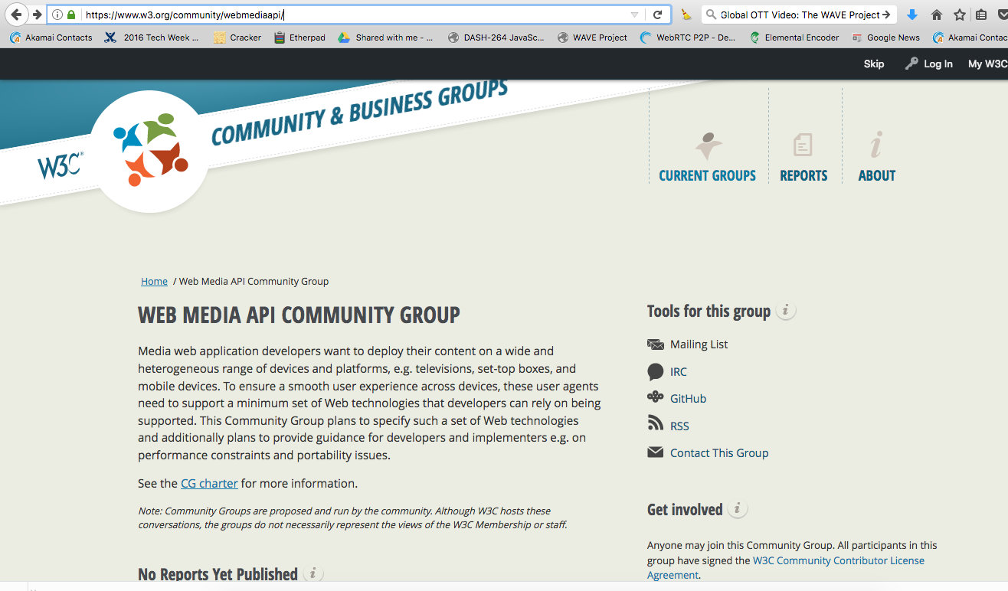
https://www.w3.org/community/webmediaapi/

Slide 29
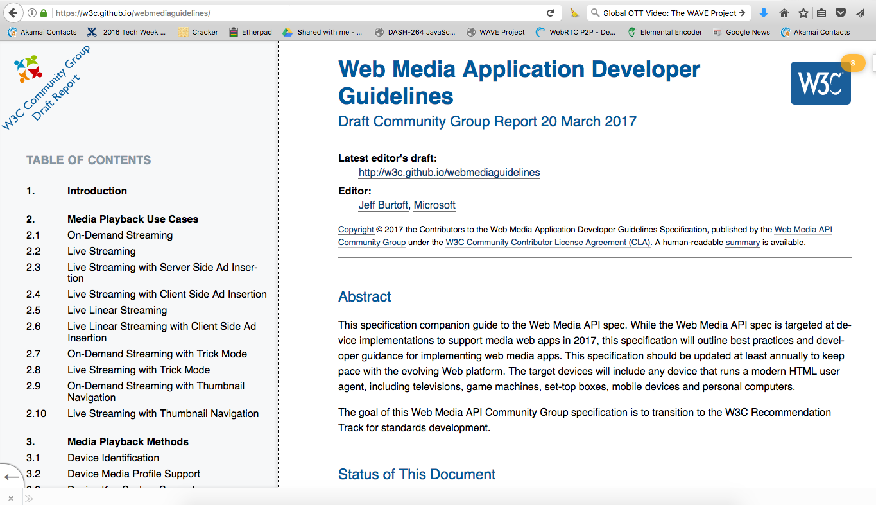

Slide 30
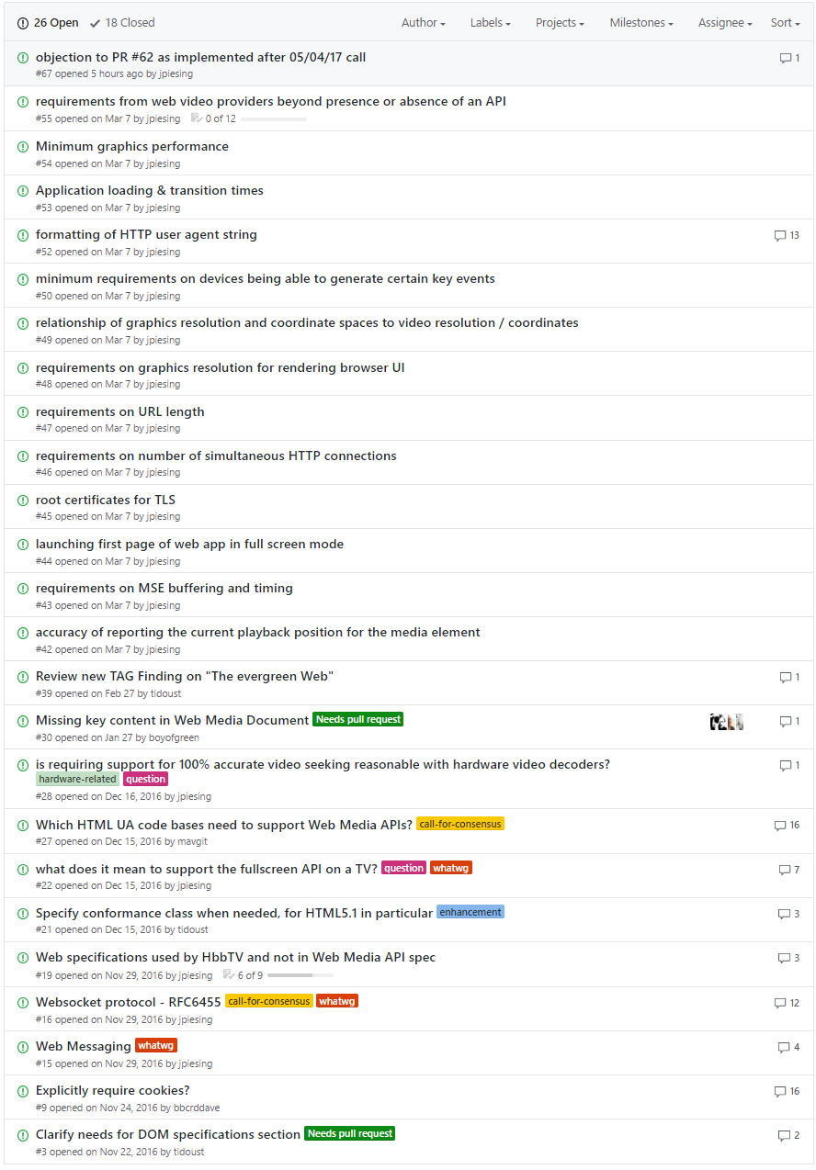
Working the Issues in the CG

Slide 31
Device Playback Capabilities Task Force

Slide 32
WAVE Organization
Steering Committee
Technical Working Group
DPCTF Device Playback Capabilities Task Force
Developing a Device Playback Capabilities Specification
  …that covers a variety of known interoperability categories from CPU+ memory “footprint” to codec compatibility
This is a broad category of “Not HTML APIs, not Content requirements”
Addressing
Content Preparation Problems
HTML5 API
Task Force
Device Playback
Capabilities
Task Force
Content Specification
Task Force
Test & Compliance Task Force

Slide 33
OTT Device Performance Challenges
Ad splicing problems
Regional profiles (50/60Hz)
Request protocol deficiencies
Unknown codec capabilities
Unknown rendering capabilities
Partial profile support
Codec incompatibility
Long-term playback instability
Late Binding Synchronization
Audio discontinuities
Glitches when switching bitrate
Memory problems
Limited processing power
Long start-up delay
Performance monitoring
DRM support
Variable HDR support
Scaling display issues
33

Slide 34
Device Types
Native App Player
HTML5 App Player
JavaScript & MSE
App-driven players:
WAVE includes different types of OTT clients, both HTML and Native
Requirements apply universally, tests focused on HTML
Native Platform Player
HTML5 Platform Player
video object
Embedded players:
Native App Devices
HTML5 App Devices

Slide 35
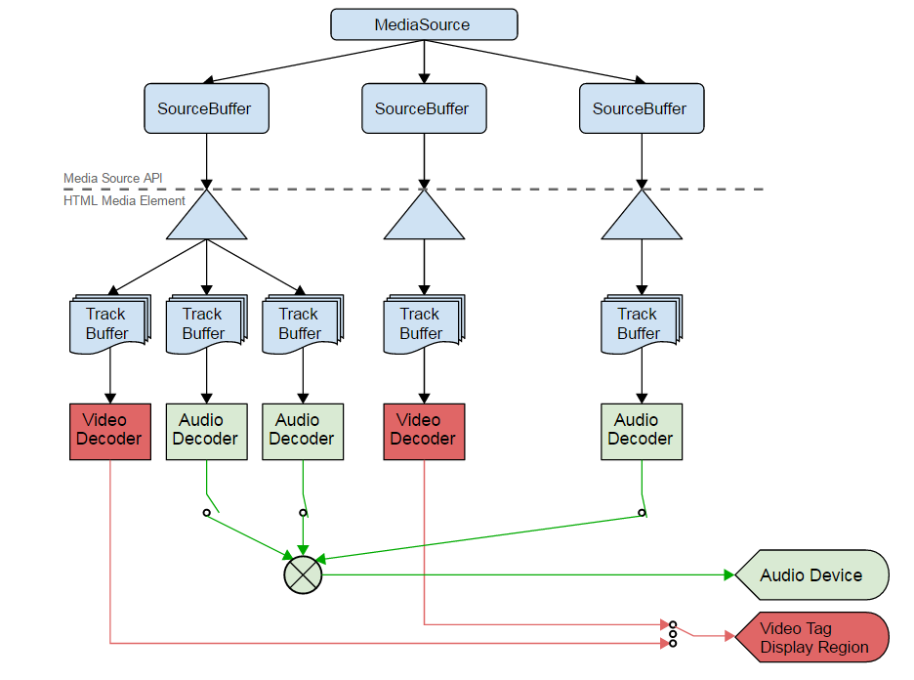
Connection to HTML5 & MSE
HTML5 and MSE
HTML5 and MSE
Provide APIs for applications to playback WAVE content
Extend APIs to ensure more consistent and richer user experience
Device Playback Platform:
Ensuring that WAVE content can be “played” consistently when using “MSE-like” APIs for different use cases and applications.
Use HTML5 as reference and test platform, not excluding other platforms
Device Platform

Slide 36
Abstracted Device Playback Model
Stimulus/Input
Device Capabilities
Observations
Audio Source Buffer
Device Playback Model
Audio Source Buffer
Visual Rendering
Video Source Buffer
Video Source Buffer
Audio Rendering
Subtitle Source Buffer
Requirements: If you input WAVE content, this shall be the observation

Slide 37
DPCTF Specification Objectives
Provide testable requirements for device performance challenges
Provide capability code points for WAVE content
Enable the qualification of existing platforms for their WAVE content playback capabilities
Generate a forward-looking specification for advanced media playback requirements, including new codecs and experiences
Prioritize challenges and address the highest priority items first

Slide 38
Device Playback Focus
Device definition:
  Codecs & Rendering, possibly on different devices (HDMI, Miracast, etc.)
Capability discovery
Playback of one Media Profile
  Player Requirements such as splicing segments, switching, random access
Playback of a Presentation
Playback of sequence of Presentation
  Splicing for example for ad insertion or program boundaries
Other playback capabilities, e.g. support for multiple decoders

Slide 39
Capability Discovery Consensus
Specification expected to support
  Media Profile query
  Media Capability query ➔ alignment with W3C Media Capability API sought
  Device type (brand, etc.)
  Possible combinations of the above
Support of a data base to collected media capabilities of device types, expected to be hosted by CTA

Slide 40
Database Concept
Offline
At runtime
Test
Device
something identifying the device-type
Content/App Provider
At runtime: "device-type"
Peripheries
playback
playback
Offline: Access Database
Test Device
For Media Profile
Database
Successful test + device-type
Device of
type A
Device of
type B

Slide 41
Test and Compliance Task Force

Slide 42
WAVE Organization
Steering Committee
Technical Working Group
TCTF Test & Compliance Task Force
Developing a Test Suite and Test Materials
  Will support self-test by content and device companies
  Materials will be suitable for compliance or certification programs
Using existing test materials where possible
Addressing
Content Preparation Problems
HTML5 API
Task Force
Device Playback
Capabilities
Task Force
Content Specification
Task Force
Test & Compliance Task Force

Slide 43
WAVE Approach to Test
Compliance program (not certification or “logo” program)
Assuming some test cases voluntarily submitted by members (e.g. Apple is volunteering some part of their HLS test suite, members will probably submit various sample files)
Assuming some test cases / tools reused (with permission) from existing regimes (e.g. DASH-IF, W3C, MPEG)
Some test cases created by WAVE
Test case repository (combination of member contributions and WAVE funded test cases) managed by WAVE

Slide 44
Verification (Test & Conformance)
Practicality:
  1000’s of tests could be identified – must prioritize
  Many test instruments could be needed (test procedures, materials, test tool/s harnesses)
    Will leverage work by others (e.g., MPEG, W3C, DASH-IF IOP, HDMI, etc.)
    Will develop purpose-built instruments, as needed
  Implementation
    Defining how the necessary tests should be done (self-test, 3rd-party; test only or full certification)
    Developing, maintaining, and providing access to test materials, etc.
Timing:
  Test & Conformance follows CS/DPC/HATF specification development to some extent
  Working with TFs to identify & prioritize use cases and test requirements

Slide 45
TCTF work packages
 | Name | Deliverables
WP1 | Set the foundation | Completed WAVE Test Approach doc
WP2 | Create the test plan | Test Plan – a list of test groups and test cases
WP3 | Define the test environment | Test Specification – definition of required test tools / harnesses
WP4 | Implement test tools / harnesses | Phased delivery of test tool/harnesses
WP5 | Implement test cases | Phased delivery of test cases
WP6 | Approve test materials & create repository | Approval process. Well managed test repository containing first approved tests
WP7 | Pilot test phase | Tests ready for general release
WP8 | Ongoing maintenance of test cases and test repository | N/A

Slide 46
2017 Deliverables
Final set of testing requirements and use cases
  Good progress to date
  A number of TRs and use cases identified
Definition of WAVE testing process and environment (tools and infrastructure required to run the tests) whether WAVE administered or via self certification/3rd parties
  Yet to be done
Body of test cases for Content, Device, and Application and test materials and tools/infrastructure needed
  Good progress
  Database created
  Technical TFs being consulted

Slide 47
Work plan – indicative
Apr
May
Jun
Jul
Aug
Sep
Oct
Nov
Dec
Jan
Feb
Mar
WP1: set foundation
Tests and test tools well defined
CSTF Finalize version 1 content Spec - media and presentation profiles - prior to IBC
WP2: create test plan
WP3: define test environment
WP4: implement test tools (phased)
6/28/2017: HATF Deadline to publish Web Media APIs 2017 for public review.
WP5: implement test cases (phased)
Q3 2017: DPCTF Test Plan for candidate requirements specification and complete specification.
Iterative delivery of tools and tests
WP6: Approve test materials & create repository
Approve
Approve
WP7: pilot tests 1
WP7: pilot tests 2
Launch and general release
WP8: maintain tests and test repository

Slide 48



Steering Committee
TWG
CSTF
HATF
DPCTF
MPEG CMAF Draft (FDIS) (public)
Web Media API Community Group
Device Playback Capabilities Specification
Content Specification
Web Media
API specification
Web Media
developer guidelines
Device Playback Issues List
CMAF non-MPEG Media Profiles
Draft
Draft
Content Specification Issues List
Issues List
Issues List
TCTF
Test Approach / Specification / Requirements / Materials / etc.

Slide 49
WRAPPING UP

Slide 50
WAVE Organization
Steering Committee
Technical Working Group
Addressing
Content Preparation Problems
HTML5 API
Task Force
Device Playback
Capabilities
Task Force
Content Specification
Task Force
Test & Compliance Task Force

Slide 51
Current WAVE Membership
Adobe Systems
AGP
Akamai
Amazon.com
Apple
AT&T
AwoX
BBC Research & Development
BitRouter
BrightCove
Cable Television Labs
castLabs
Comcast Cable
Consumer Technology Association
Cox Communications
Discovery Communications
Disney/ABC/ESPN
Dolby Laboratories
DTS
Ericsson
Eurofins Digital Testing
Facebook
Fraunhofer
Google
Home Box Office (HBO)
Intel Corporation
JW Player
LG Electronics
Microsoft Corporation
MLBAM
Motion Picture Association of America
Motion Picture Labs
Nagravision
National Association of Broadcasters
Netflix
Opera Software
P Thomsen Consulting
Qualcomm Incorporated
RK Entertainment Technology Consulting
Samsung Electronics
Sharp Electronics Corporation
Sky
Society of Cable Telecommunications Engineers
Solekai Systems
Sony Electronics
SpireSpark International
Starz
Streamroot
TBT
Toshiba
TP Vision Holding B.V.
Ustudio
Verance Corporation
Verimatrix
Verizon
Viacom
Vizio
WJR Consulting
World Wide Web Consortium
WWE
Company names in bold are members of the WAVE Steering Committee.

Slide 52
Join WAVE by emailing
standards@CTA.tech

